Slide 1
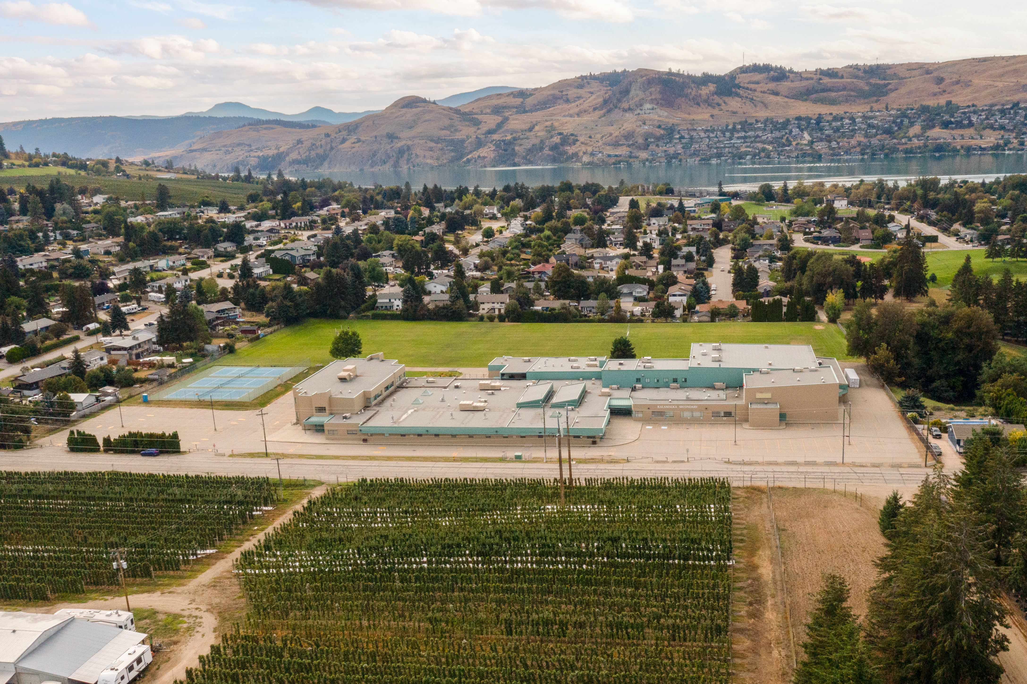

Kalamalka
Gr. 10 COURSE SELECTION 2025/2026

Slide 2

What is course selection?
Courses you want
School schedule
Student ownership
Opens post-Kal doors

Slide 3
What courses can I take?
See Course Planning Book on the Kal website
Each grade has a set of core and elective courses that you can request
Core – classes that are mandatory in each grade
Elective – courses that you choose to take in each grade
As you move through grades 8-12, more of your courses become electives as you focus on a particular area of study

Slide 4
Grade 10
Core (6 courses) |  | Electives (pick 2 courses)
1. Language Arts 10 Pick ONE of the following | English 10 (Literary Studies & New Media, Composition, Spoken Language, or Creative Writing) | French 10 | Studio Art 3D 10
 | English First Peoples 10 (Literary Studies & Writing) | Intro Spanish 11 | Visual Arts/Photography 10
 | Humanities 10 (Linear EFP 10 and Socials 10) | Textiles 10 | Drama 10
2. Math 10 Pick ONE of the following | Foundations of Math / Pre-Calculus 10 | Food Studies 10 | Musical Theatre 10
 | Workplace Math 10 | Woodworking 10 | Theatre Company 10
3. Science 10 |  | Skills Exploration 10 | Stagecraft 10
4. Physical Health Education 10 Pick ONE of the following | PHE 10 (competitive) | Electronics/Robotics 10 | Yearbook 10 (Out of Timetable)
 | PHE 10 – Recreational (non-competitive) | Computer Studies 10 | Leadership 10 (Out of Timetable)
 | A confirmed academy | Band 10 | Jazz Band 10 (Out of Timetable)
5. Social Studies 10 (unless you select Humanities 10) |  | Art Studio 10 | Choir 10 (Out of Timetable)
6. Career Life Education 10 |  | Studio Art 2D 10

Slide 5
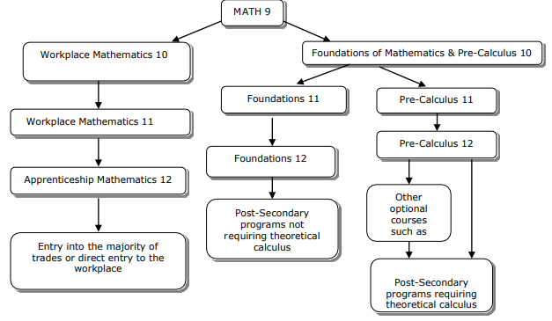

Slide 6
BC Certificate of Graduation (aka, Dogwood)
Requires 80 credits in your grade 10-12 years
Most courses = 4 credits
Most students take 8 courses per year
By the end of grade 10, most students will have 32 credits towards their Dogwood

Slide 7
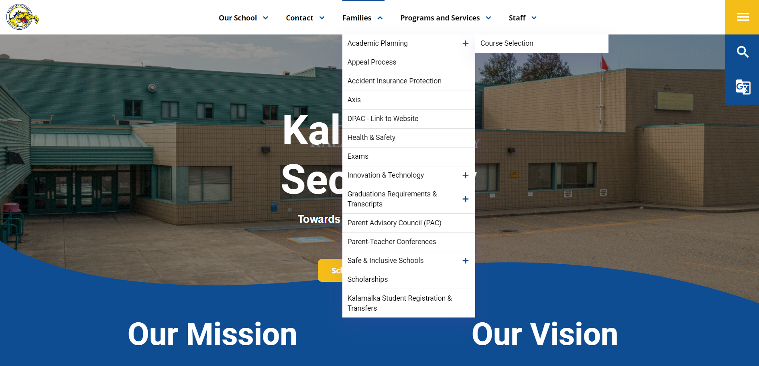
How does course selection work?
Research courses in the Course Planning Book BEFORE course selection day (Tuesday March 4)
Note: not all courses in the Course Planning Book will run ☹ depends on enrolment

Slide 8
How does course selection work?
Before course selection day, log into MyBlueprint and create a Gr.10 Plan
Ensure you select 6 required core courses and 2 elective courses
Ensure you are planning to have 32 credits by the end of Gr.10
On course selection day, refer to this plan when selecting your courses

Slide 9
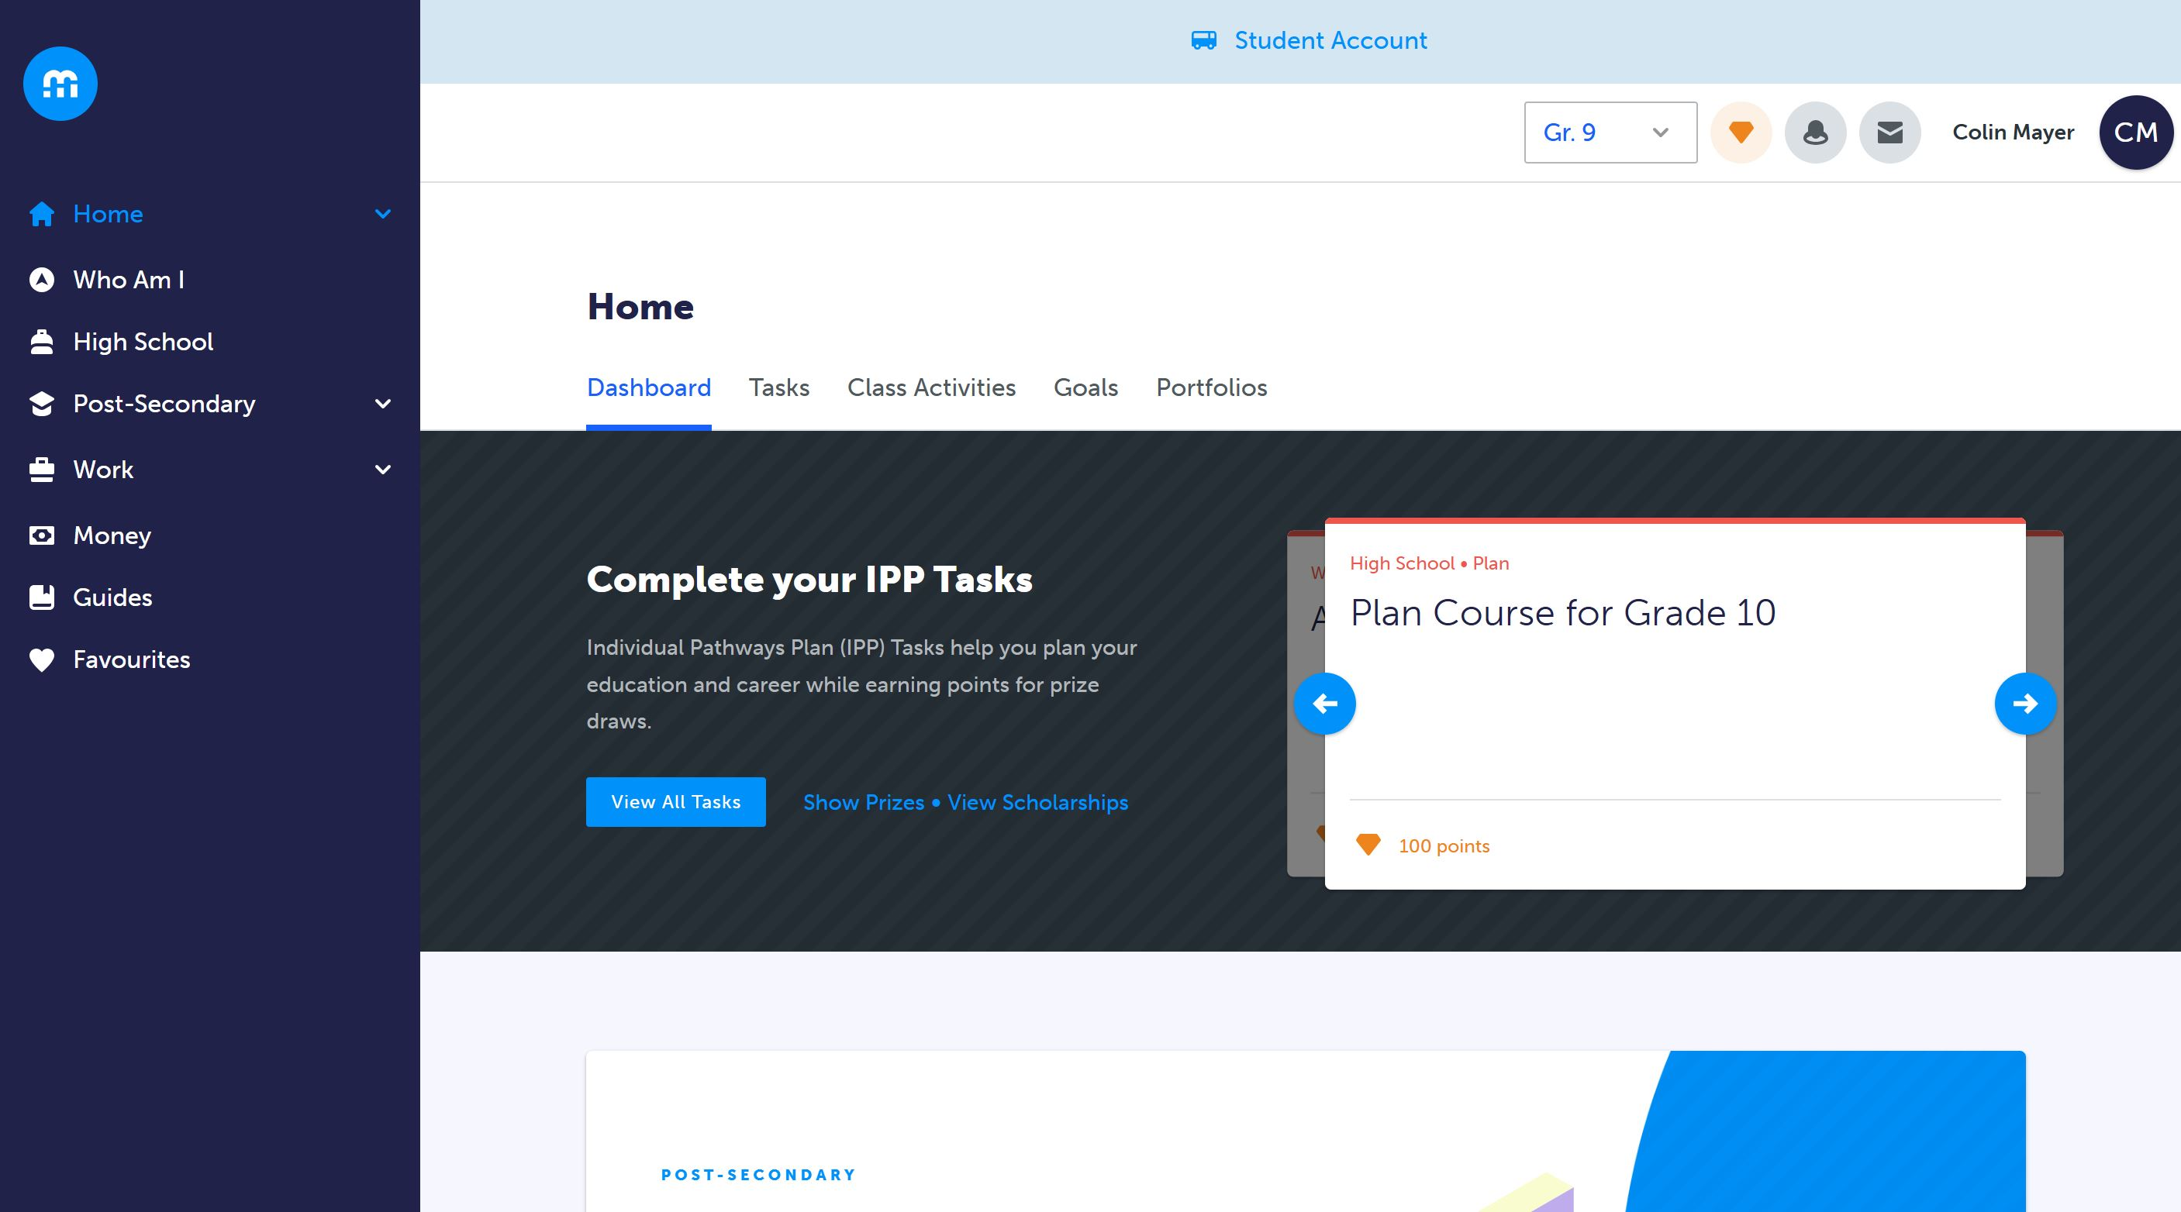
Notes:
Read the instructions before you begin!

Slide 10
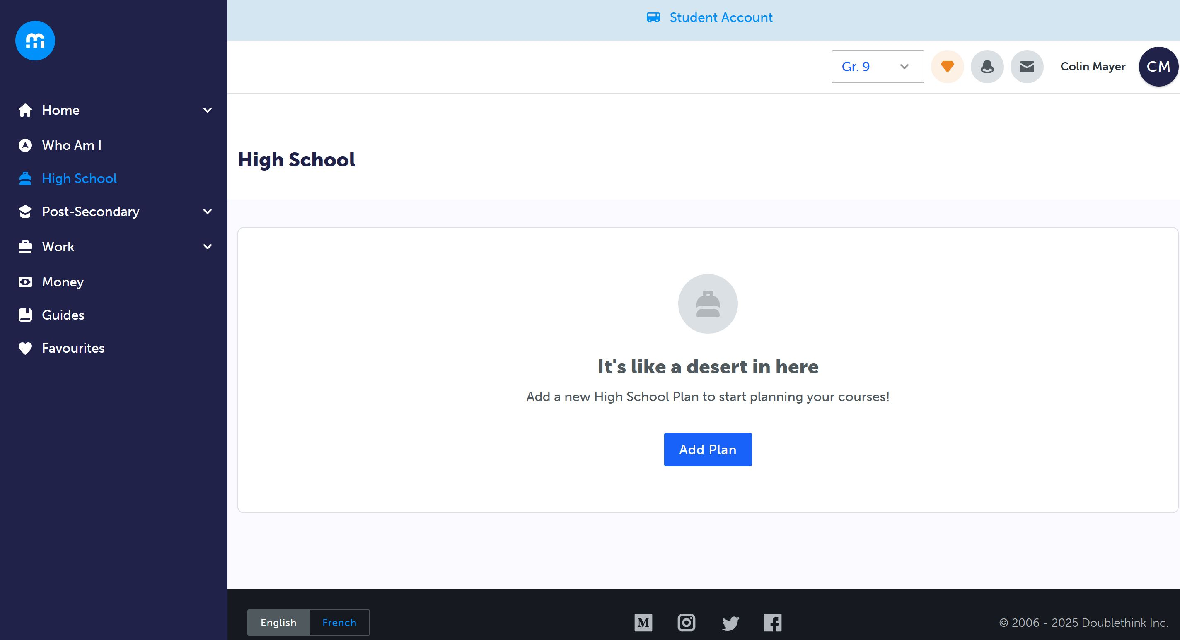
Notes:
Ensure you select all your electives – read the instructions here too!

Slide 11
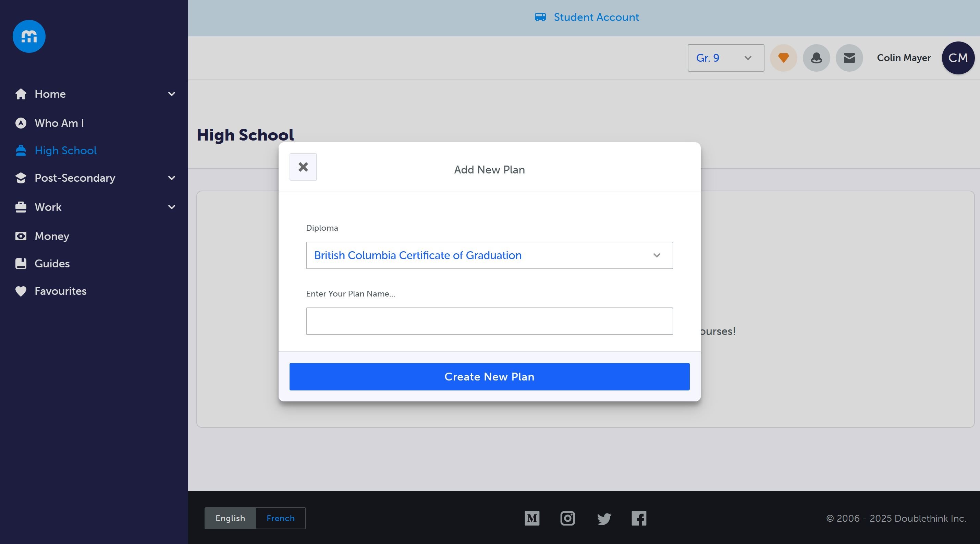
Notes:
Ensure you get your parent / guardian to type their name, and select “Send me an email receipt of my responses!

Slide 12
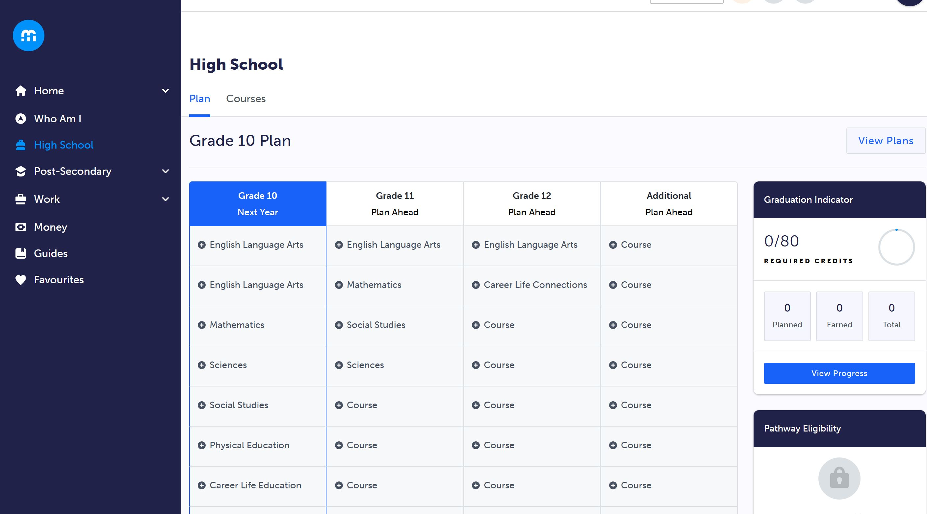

Slide 13
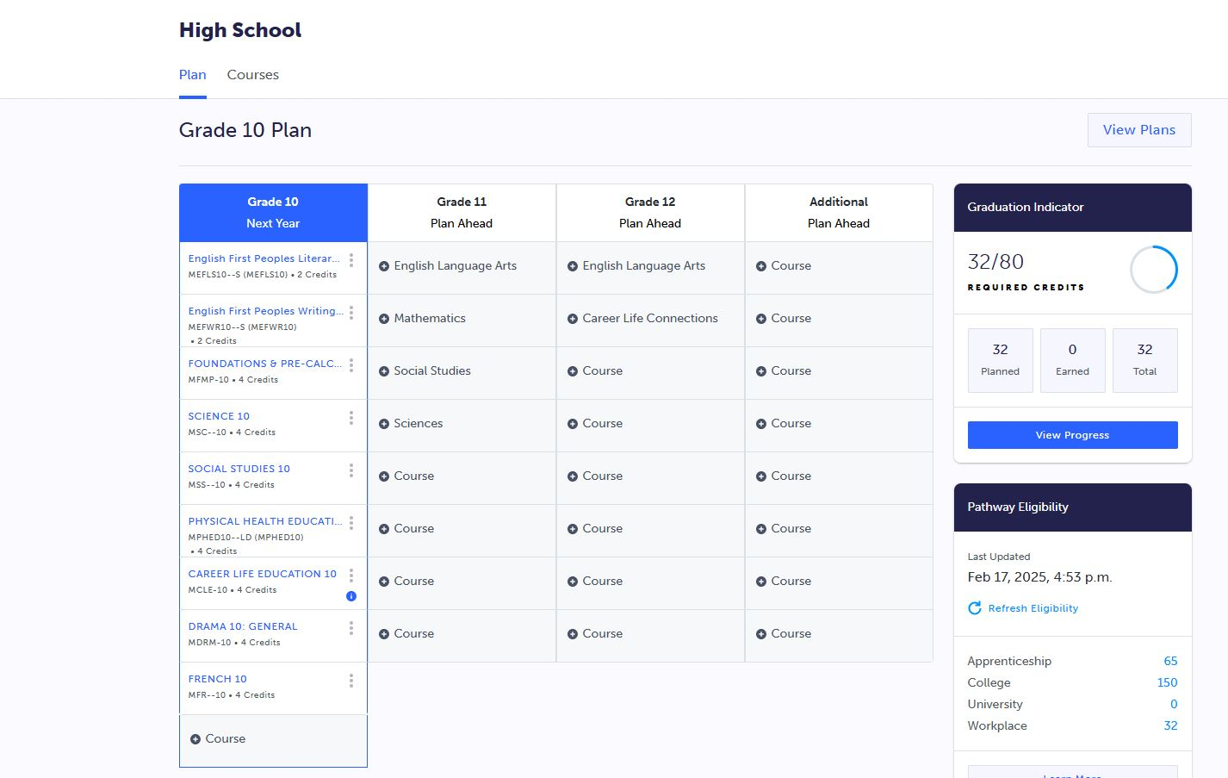

Slide 14
How does course selection work?
On course selection day, log in to MyED > My Info > Requests
Read the instructions!
Select each course (both primary and alternates)
Ensure you have prioritized your alternates, with the most desirable being #1
If you plan to enroll in an online course or academy, you need to enroll in the in-school course first!
Once you have selected all your courses, ask an admin or counsellor to review your selections to ensure they meet all requirements
Click OK to save all your course requests

Slide 15
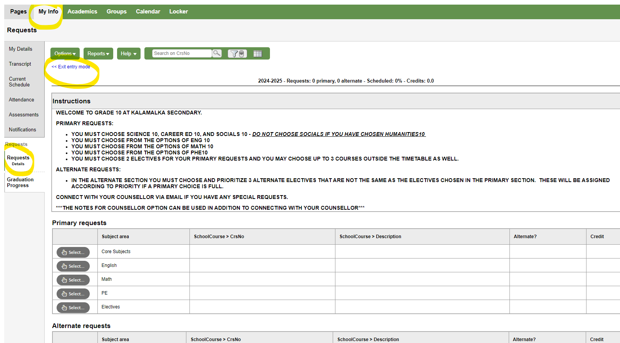

Slide 16
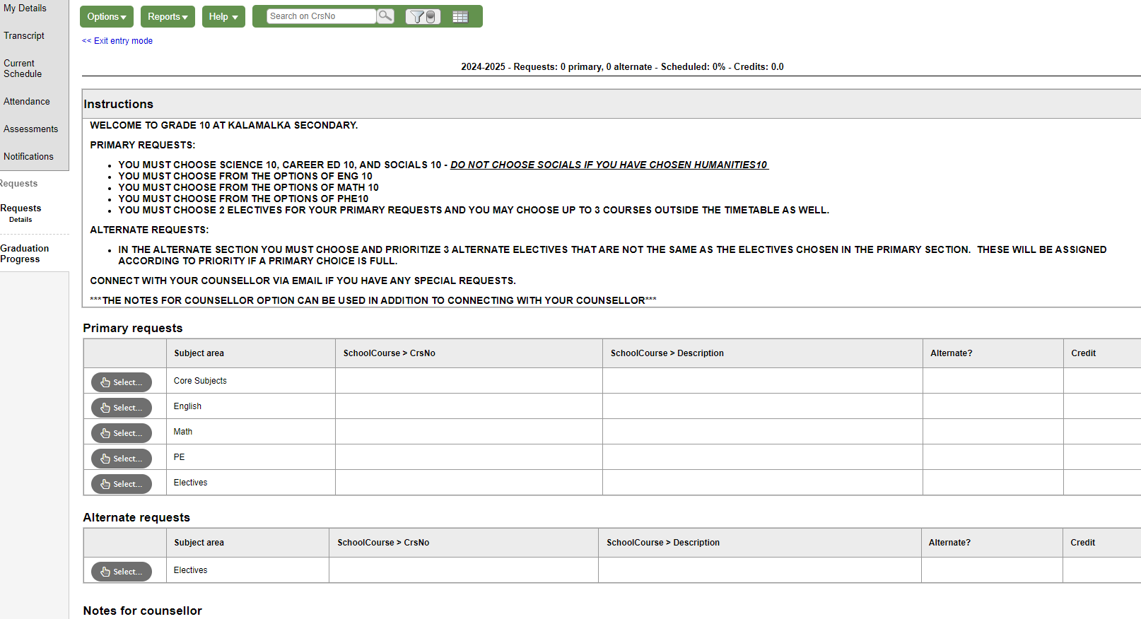
Notes:
Make sure you follow the instructions and search the course codes

Slide 17
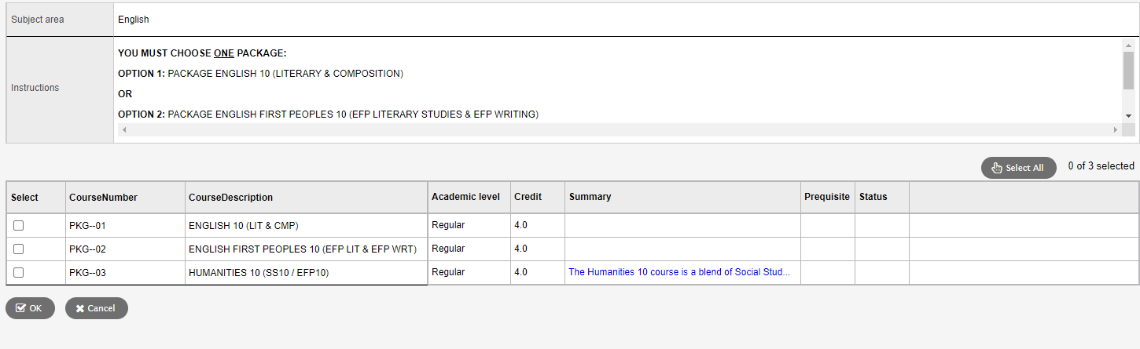

Slide 18
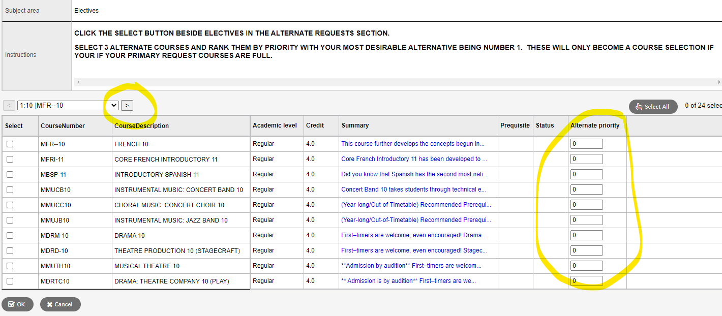
Notes:
Make sure you click on the arrow to see all course options, especially many of the electives!!!
Rank your electives by priority, with most desirable #1

Slide 19
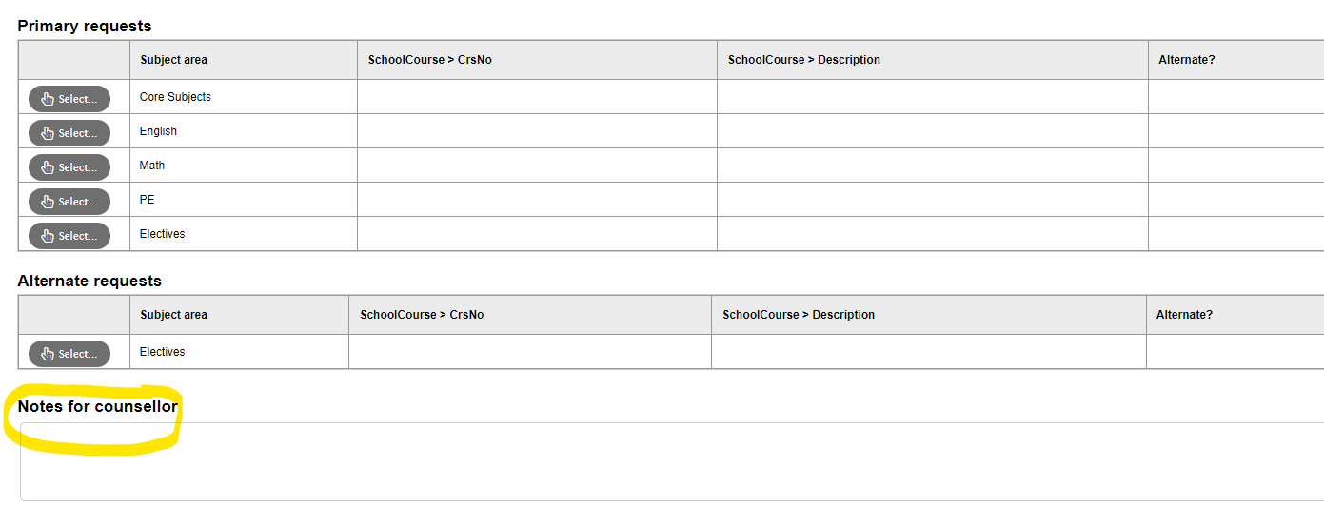
Notes:
Add any special requests or notes for your counsellor, or better yet, speak to them directly. No guarantee that we can accommodate these requests.

Slide 20

So how do I decide which courses to take?
Speaking to the teacher(s) and counsellors
Review course descriptions
Research Post-Secondary Entrance Requirements
Chat with friends who have taken the course

Slide 21


Slide 22
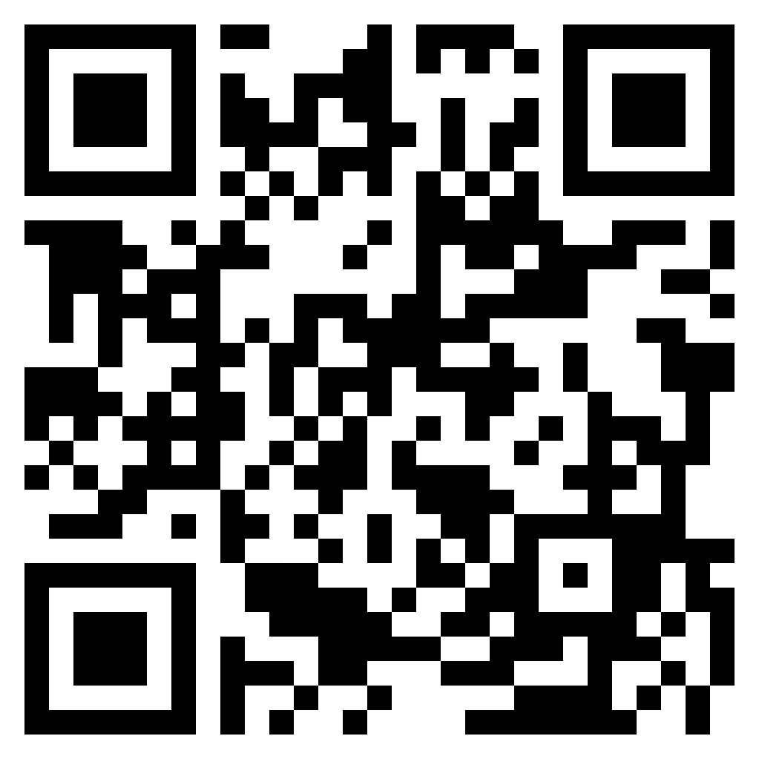
https://kalamalka.sd22.bc.ca/course-selection
YOU GOT THIS!

