Slide 1
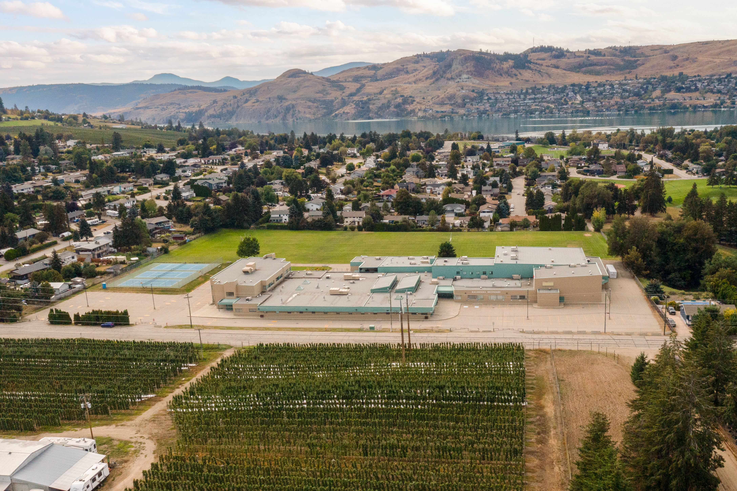

Kalamalka
Gr. 9 COURSE SELECTION 2025/2026

Slide 2

What is course selection?
Courses you want
School schedule
Student ownership
Opens post-Kal doors

Slide 3
What courses can I take?
See Course Booklet 2025-2026 on the Kal website
Each grade has a set of core and elective courses that you can request
Core – classes that are mandatory in each grade
Elective – courses that you choose to take in each grade
As you move through grades 8-12, more of your courses become electives as you focus on a particular area of study

Slide 4
Grade 9
Core | Electives (pick 3)
English 9 | French 9 | Art 9
Science 9 | Home Economics 9 (both Textiles 9 and Foods 9 in one semester) | Computer Studies 10
Mathematics 9 | ADST Textiles 9 | Drama 9
Social Studies 9 | ADST Foods 9 | Theatre Performance 9
Physical Education 9 (competitive OR recreational) | ADST Electronics / Robotics 9 | Concert Band 9
Career Education 9 (embedded with other classes) | ADST Woodworking 9 | Jazz Band 9 (Out of Timetable)
 | ADST Entrepreneurship 9 | Choir 9 (Out of Timetable)

Slide 5
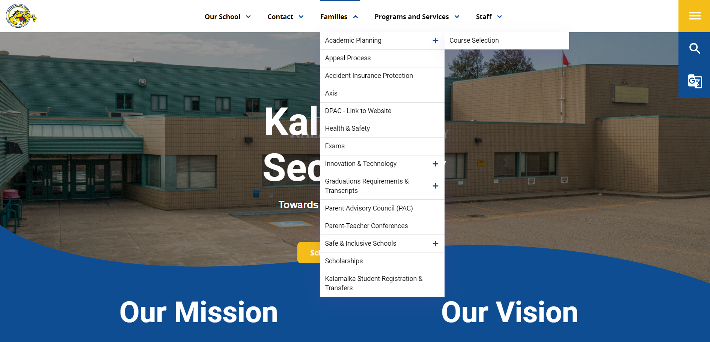
How does course selection work?

Slide 6
How does course selection work?
Take Gr.9 Course Planning Tool home
Research courses in the Course Booklet
Fill out the Gr.9 Course Planning Tool
Bring the Gr.9 Course Planning Tool with you on course selection day (Tuesday March 4th) and use it as a guide to complete your course selection in MyED

Slide 7
How does course selection work?
On course selection day, log in to MyED > My Info > Requests
Read the instructions!
Select each course (both primary and alternates)
Ensure you have prioritized your alternates, with the most desirable being #1
  If you plan to enroll in an online course or academy, you need to enroll in the in-school course first!
Once you have selected all your courses, ask an admin or counsellor to review your selections to ensure they meet all requirements
Click OK to save all your course requests

Slide 8
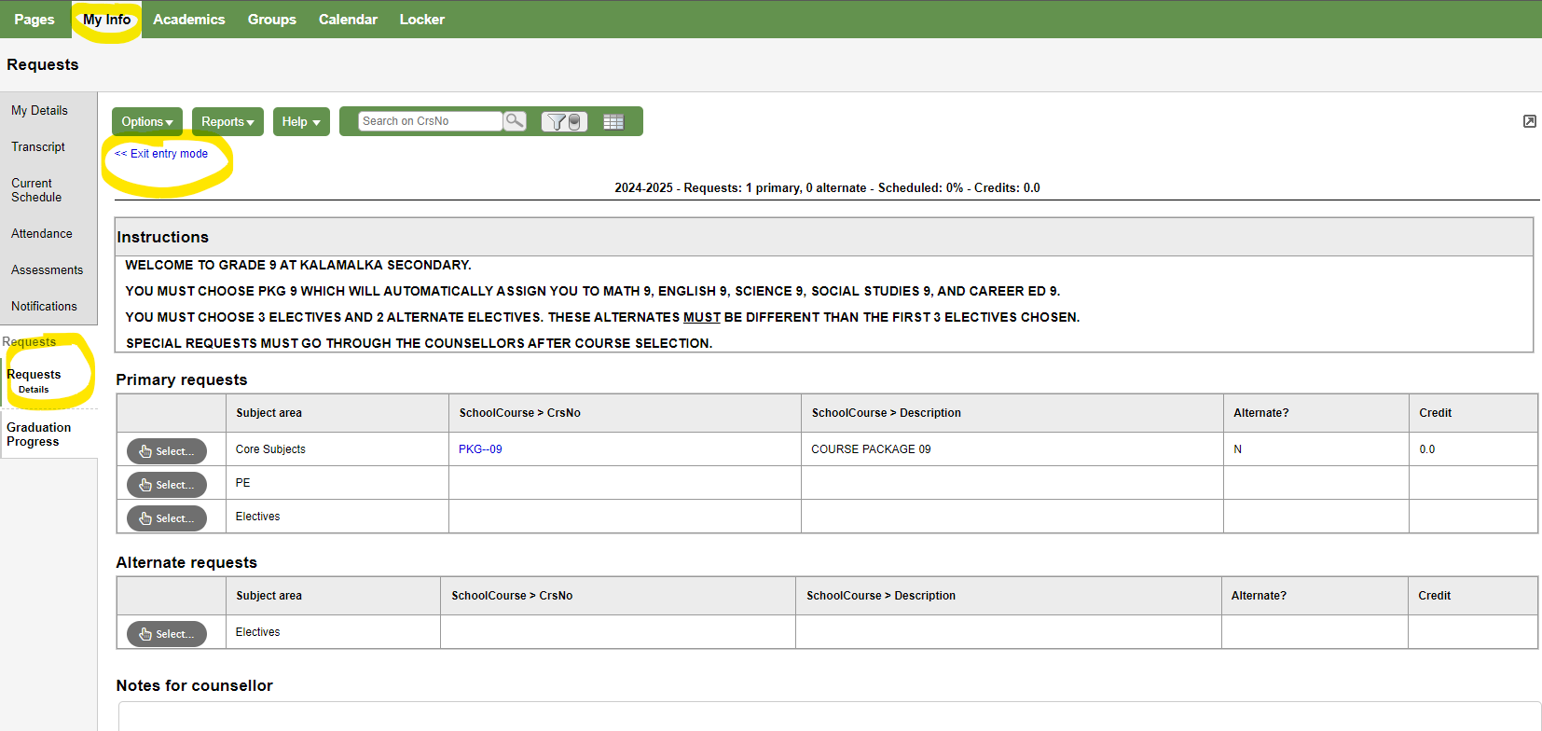

Slide 9
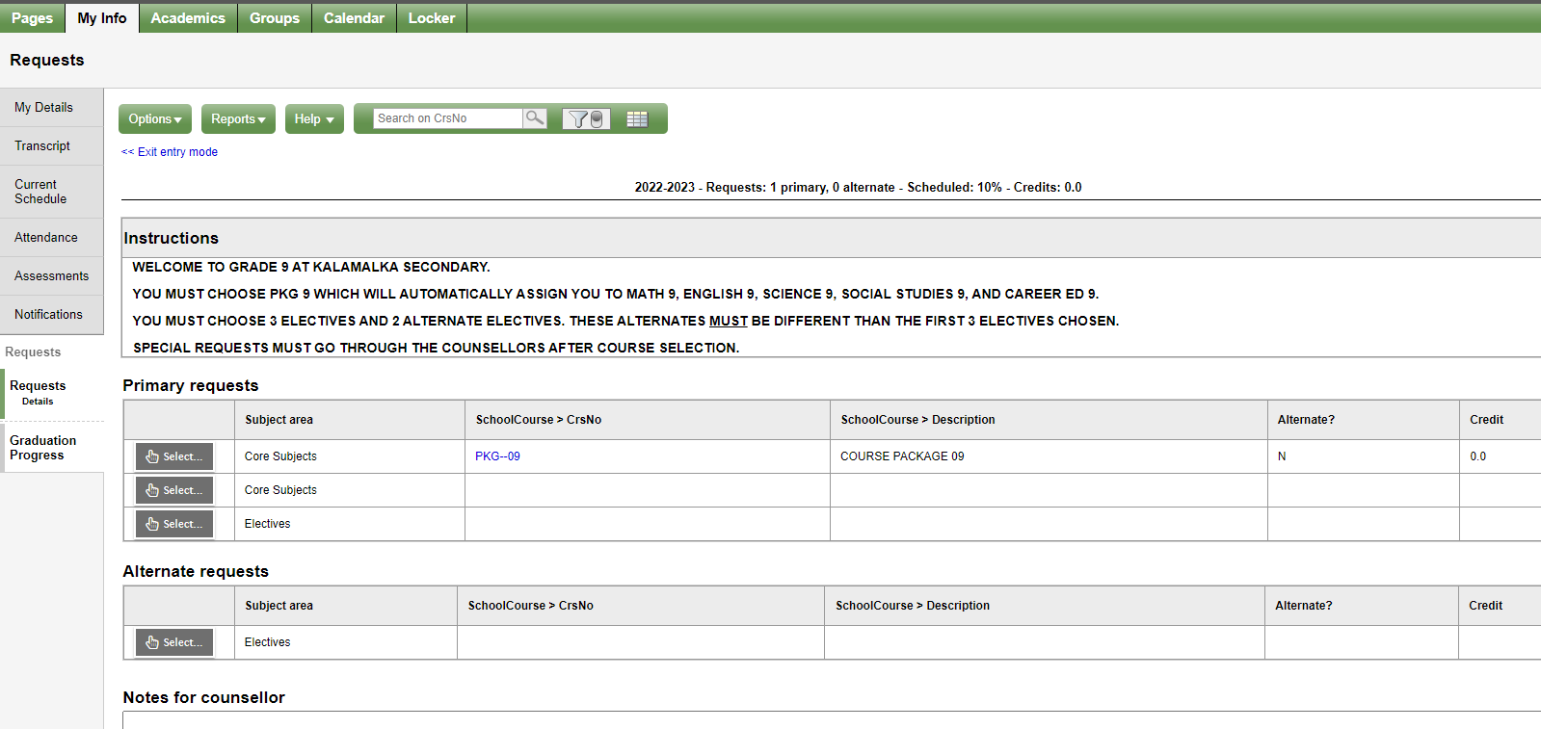
Notes:
Make sure you follow the instructions and search the course codes

Slide 10
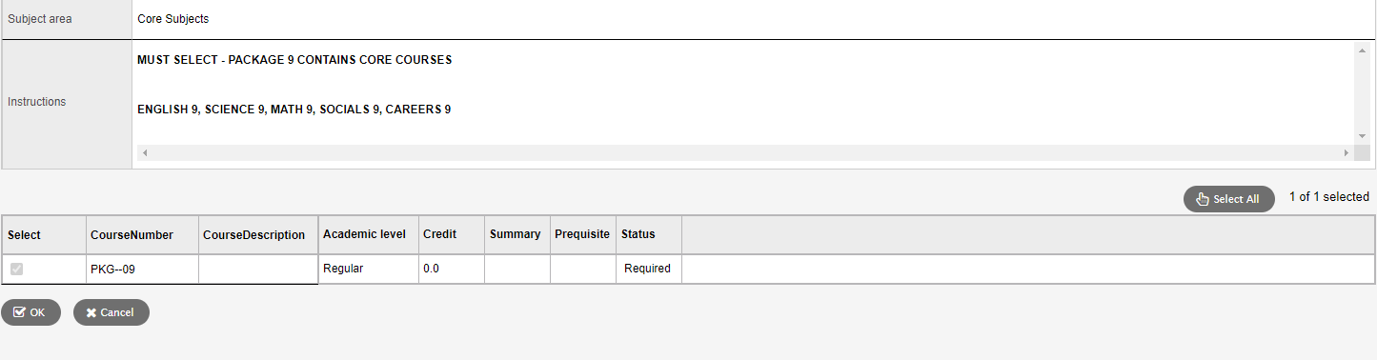

Slide 11
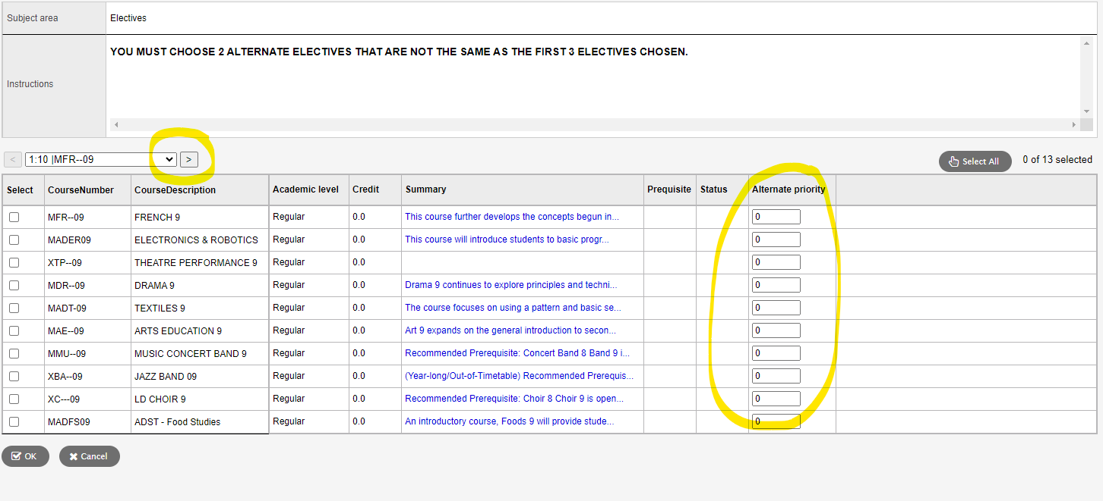
Notes:
Make sure you click on the arrow to see all course options, especially many of the electives!!!
Rank your electives by priority, with most desirable #1

Slide 12
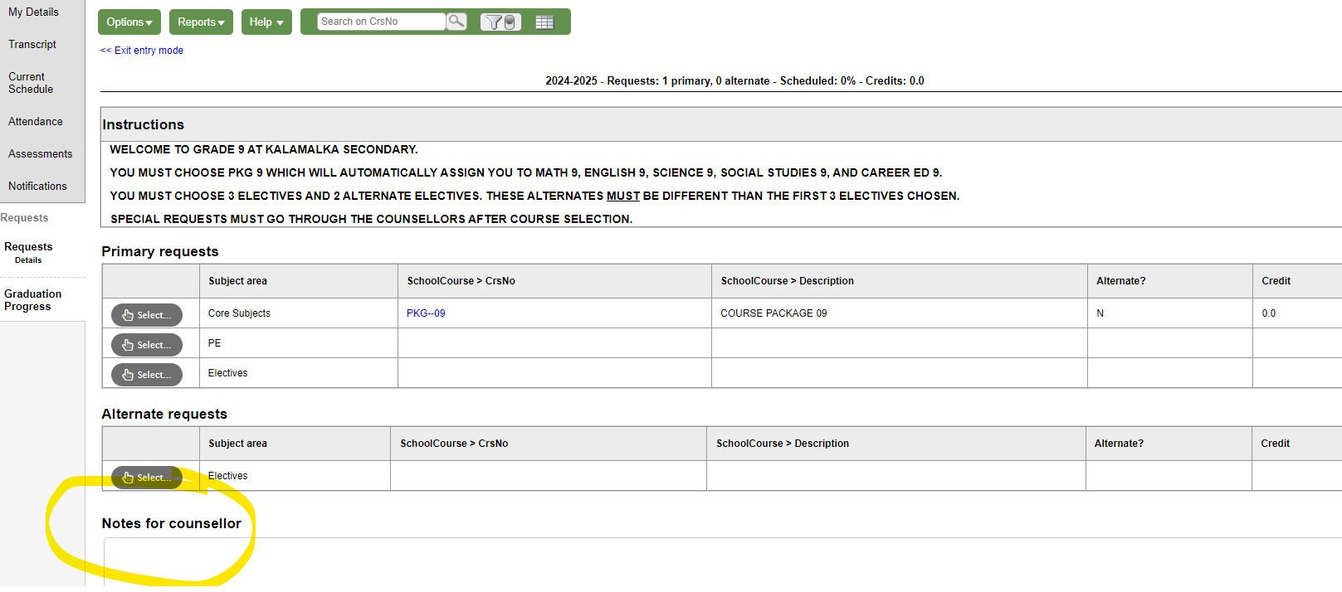
Notes:
Add any special requests or notes for your counsellor, or better yet, speak to them directly. No guarantee that we can accommodate these requests.

Slide 13

So how do I decide which courses to take?
Speaking to the teacher(s) and counsellors
Review course descriptions
Research Post-Secondary Entrance Requirements
Chat with friends who have taken the course

Slide 14


Slide 15
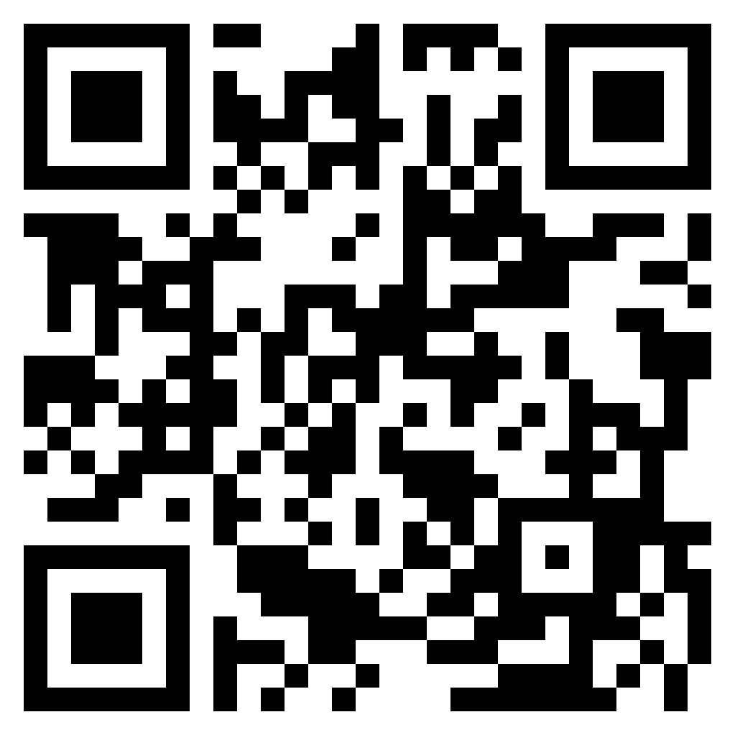
https://kalamalka.sd22.bc.ca/course-selection
YOU GOT THIS!

