Slide 1
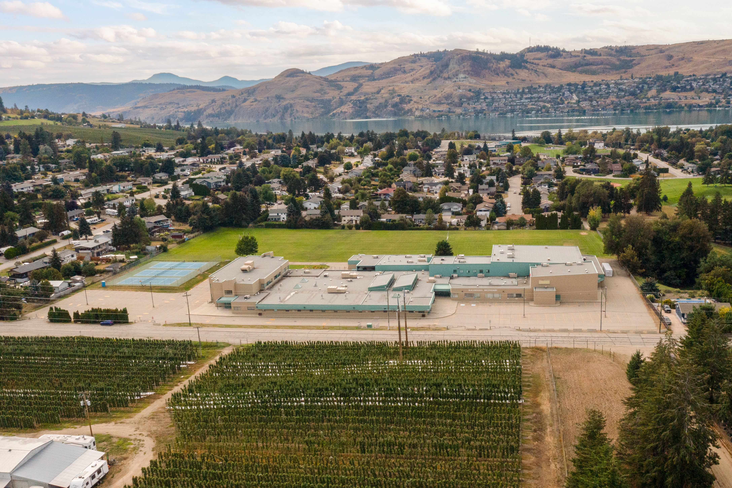

Kalamalka
Gr. 12 COURSE SELECTION 2025/2026

Slide 2

What is course selection?
Courses you want
School schedule
Student ownership
Opens post-Kal doors

Slide 3
What courses can I take?
See Course Planning Book on the Kal website
Each grade has a set of core and elective courses that you can request
Core – classes that are mandatory in each grade
Elective – courses that you choose to take in each grade
As you move through grades 8-12, more of your courses become electives as you focus on a particular area of study

Slide 4
Grade 12
Mandatory courses (2) – must enrol in at least one course from the following learning areas:
1. English 12 – must choose ONE of the following | English Studies 12 / English First Peoples 12 / AP Literature & AP Language & English 12 (Linear, 12 credits)
2. Career Education – must choose ONE of the following in gr.11 or 12 | Career Life Connections 12 (in-class) / Career Life Connections 12 (OTT)
IMPORTANT: If you have not enrolled in an Indigenous-focused course in grade 10 or 11 (e.g., EFP 10, EFP 11, or Contemporary Indigenous Studies 12), you MUST enrol in either EFP 12 OR Contemporary Indigenous Studies 12 (social studies elective)
Notes:
English – Need FP course in gr.10, 11, or 12 to graduate
Most unis need a language 11 for admission
LOOK AT UNI ADMISSION REQs BEFORE FINALIZING! Science? Take more science! Arts? Take more arts!

Slide 5
Grade 12
Elective courses (6 if you need CLC12, 7 if you took CLC12 in gr.11) - any SIX / SEVEN courses from the list below
Explorations in SS 11 | Foundations of Math 11 | Earth Science 11 | Women’s Fitness 12 | Studio Art 3D 12 | Peer Tutoring 12
Physical Geography 12 | Pre-Calculus 11 | Environmental Science 12 | Outdoor Education 12 | Graphic Arts 12 | Yearbook 12 (OTT)
Law Studies 12 | Pre-Calculus 12 | French 11 | Robotics 12 | Photography 12 | Leadership 12 (OTT)
Social Justice 12 | Pre-Calc / AP Calc 12 | French 12 | Food Studies 12 | Concert Band 12 | Jazz Band 12 (OTT)
20th Century World History 12 | Chemistry 11 | Intro Spanish 11 | Textiles 12 | Drama 12 | Chamber Choir 12 (OTT)
Contemporary Indigenous Studies 12 | Chemistry 12 | Spanish 11 | Fashion Industry 12 | Musical Theatre 12 | OC Dual Credit Courses – see counsellors
Psychology 12 | Life Science 11 | Spanish 12 | Woodworking 12 | Theatre Company 12
AP Psychology 12 | Anatomy & Physiology 12 | PHE Active Living 12 | Skills Exploration 12 | Stagecraft 12
Economics 12 | Physics 11 | PHE 12 Sports Leadership | Art Studio 12 | Directing & Script 12
Workplace Math 11 | Physics 12 | Fitness & Conditioning 12 | Studio Art 2D 12 | Film Studies 12
Notes:
English – Need FP course in gr.10, 11, or 12 to graduate
Most unis need a language 11 for admission
LOOK AT UNI ADMISSION REQs BEFORE FINALIZING! Science? Take more science! Arts? Take more arts!

Slide 6
BC Certificate of Graduation (aka, Dogwood)
Requires 80 credits in your grade 10-12 years
Most courses = 4 credits
Most students take 8 courses per year
By the end of grade 12, most students will have more than 80 credits towards their Dogwood

Slide 7
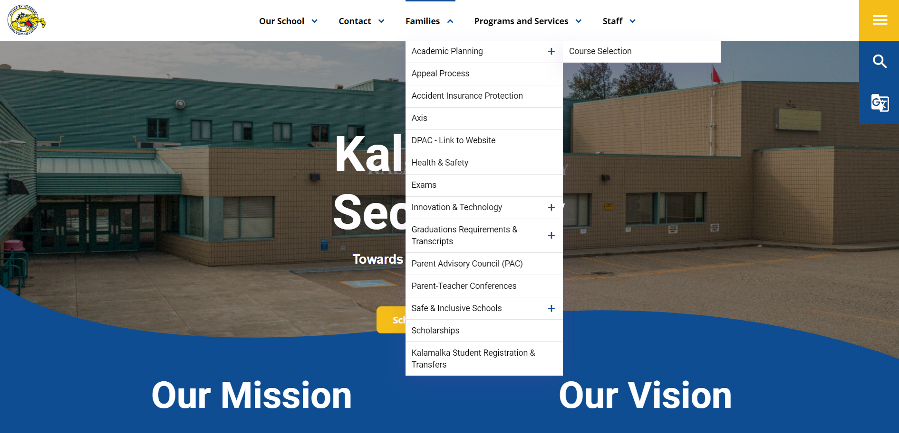
How does course selection work?
Research courses in the Course Planning Book BEFORE course selection day (Tuesday March 4)
Note: not all courses in the Course Planning Book will run ☹ depends on enrolment

Slide 8
How does course selection work?
Before course selection day, log into MyBlueprint and create a Gr.12 Plan
  Ensure you select an English 12 course and CLC12 if you have yet to complete it in Gr.11
  If you have yet to take an Indigenous-focused course that satisfies the Indigenous Graduation Requirement, you MUST enroll in English First Peoples 12 or Contemporary Indigenous Studies 12
  Ensure you are planning to have 80 credits or more by the end of Gr.12
On course selection day, refer to this plan when selecting your courses

Slide 9
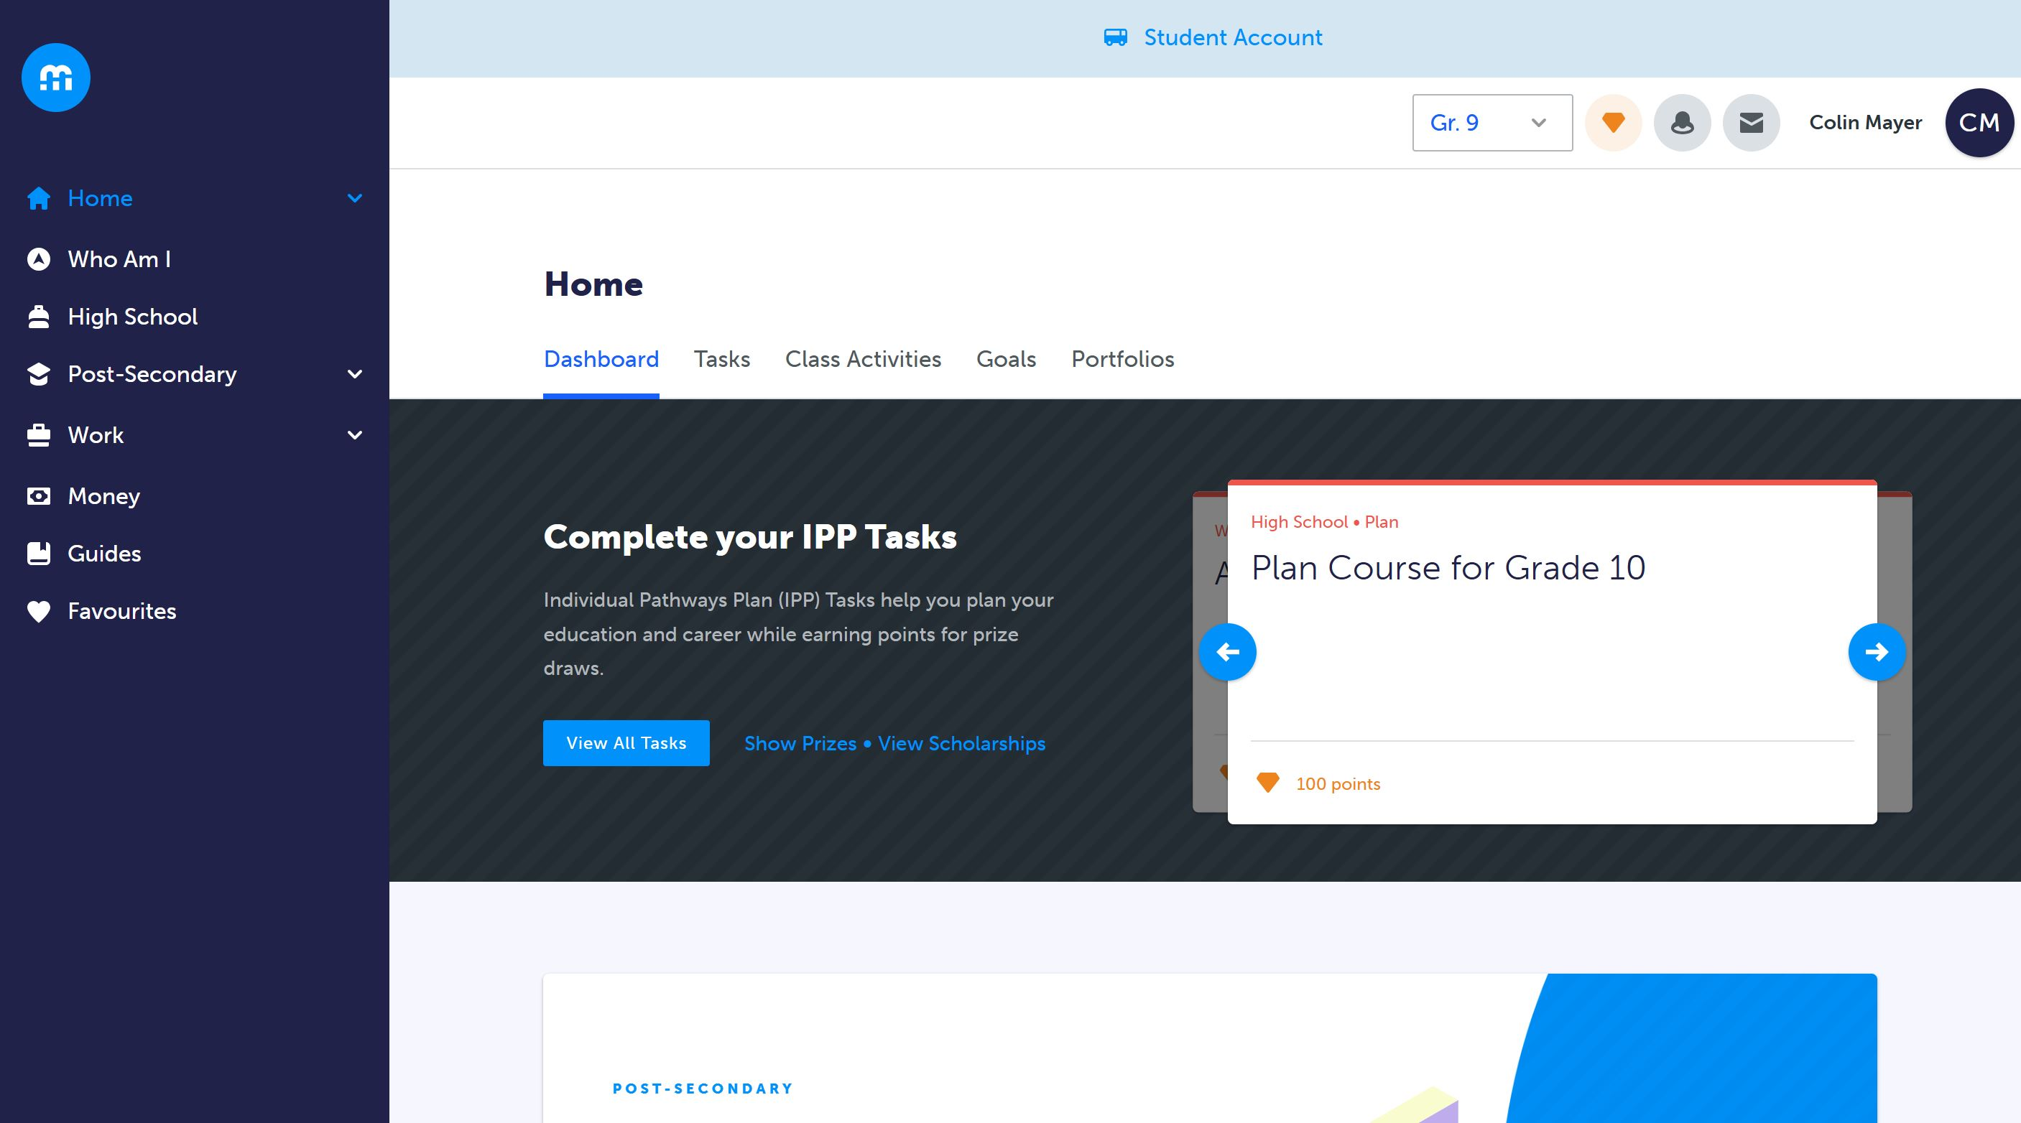
Notes:
Read the instructions before you begin!

Slide 10
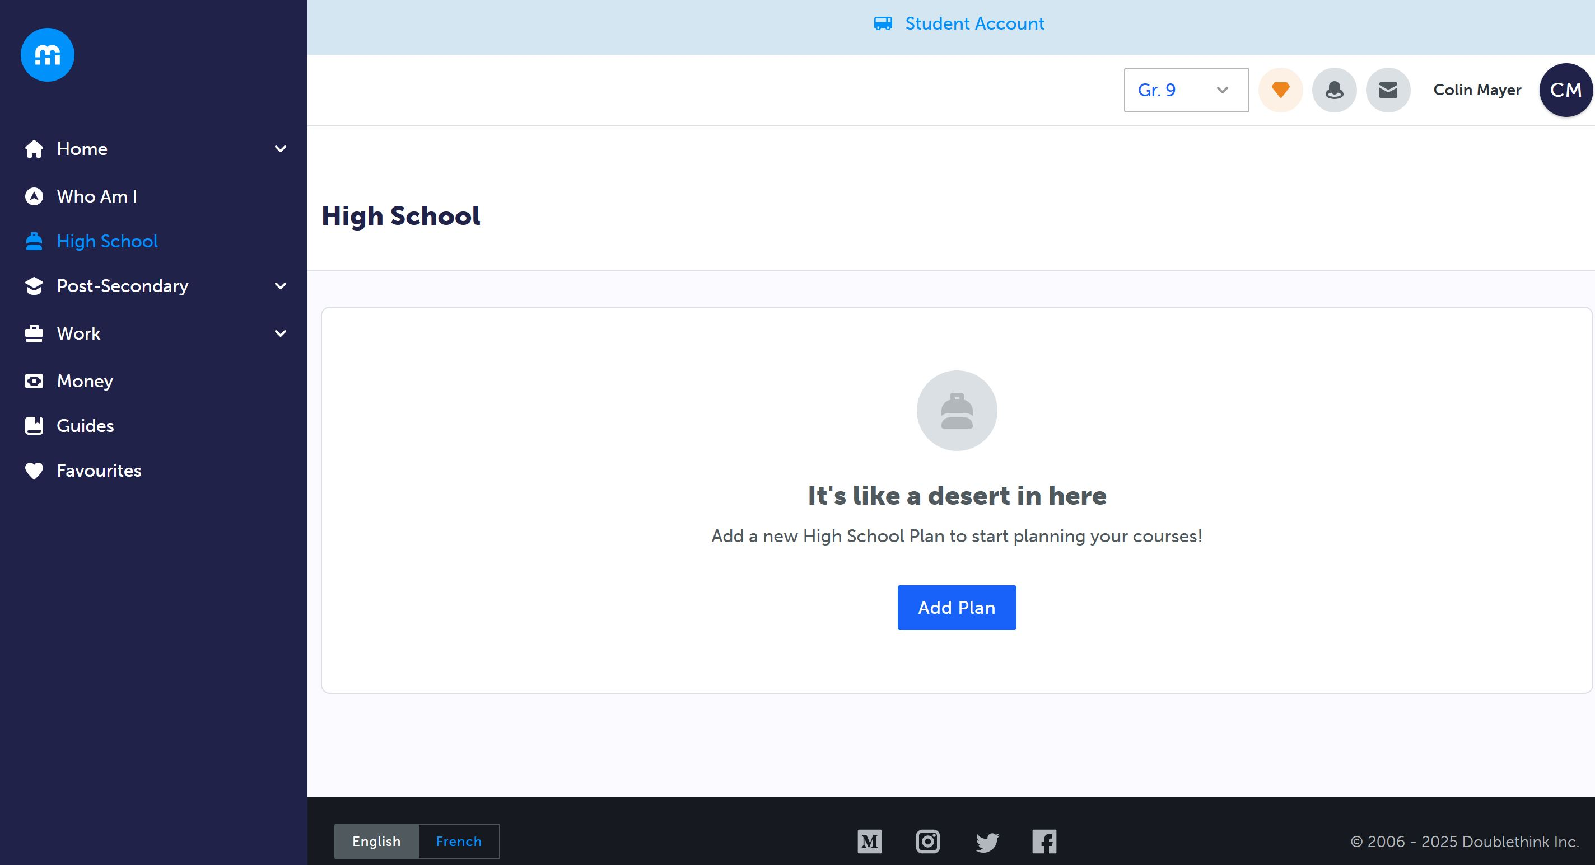
Notes:
Ensure you select all your electives – read the instructions here too!

Slide 11
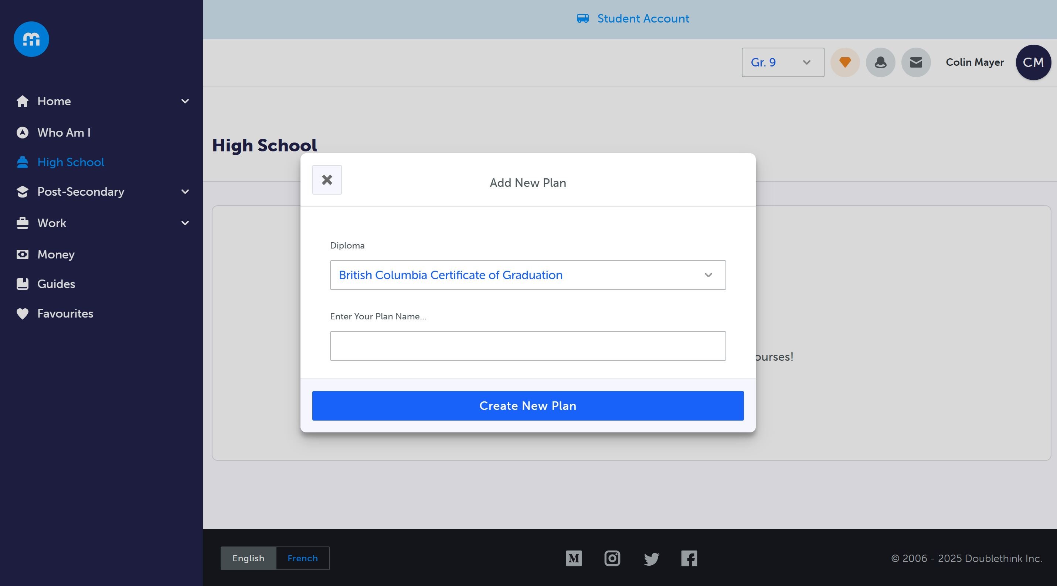
Notes:
Ensure you get your parent / guardian to type their name, and select “Send me an email receipt of my responses!

Slide 12
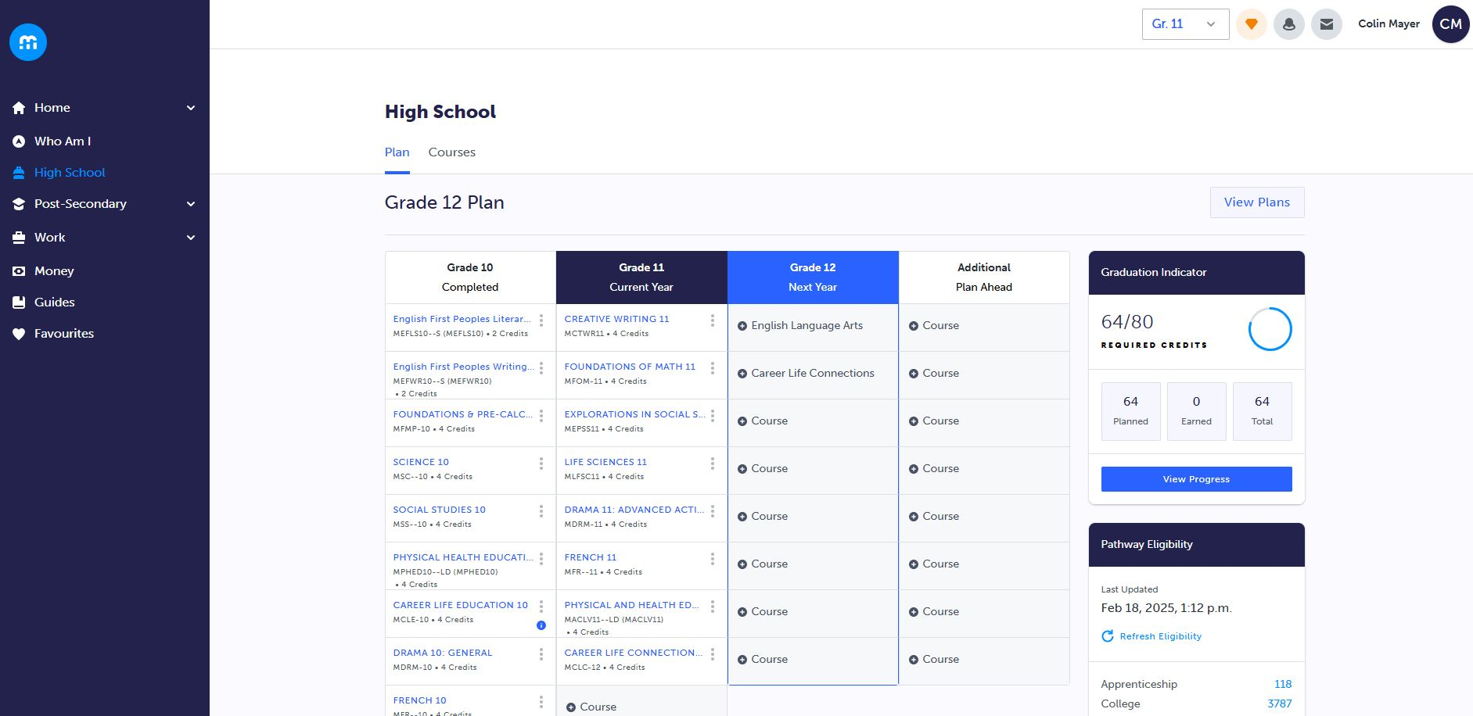

Slide 13
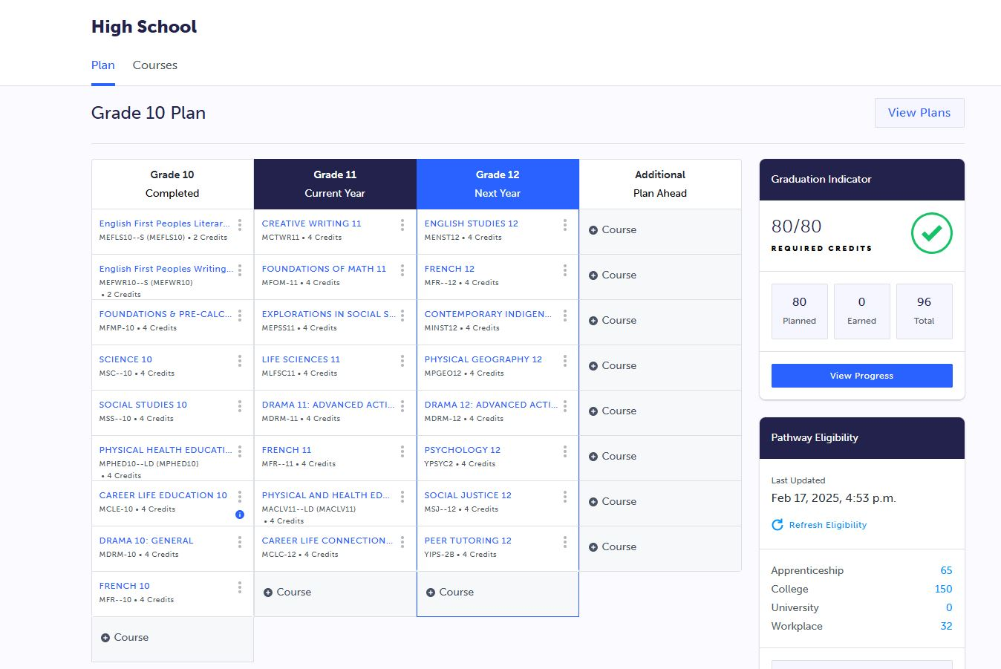

Slide 14
How does course selection work?
On course selection day, log in to MyED > My Info > Requests
Read the instructions!
Select each course (both primary and alternates)
Ensure you have prioritized your alternates, with the most desirable being #1
  If you plan to enroll in an online course or academy, you need to enroll in the in-school course first!
Once you have selected all your courses, ask an admin or counsellor to review your selections to ensure they meet all requirements
Click OK to save all your course requests

Slide 15
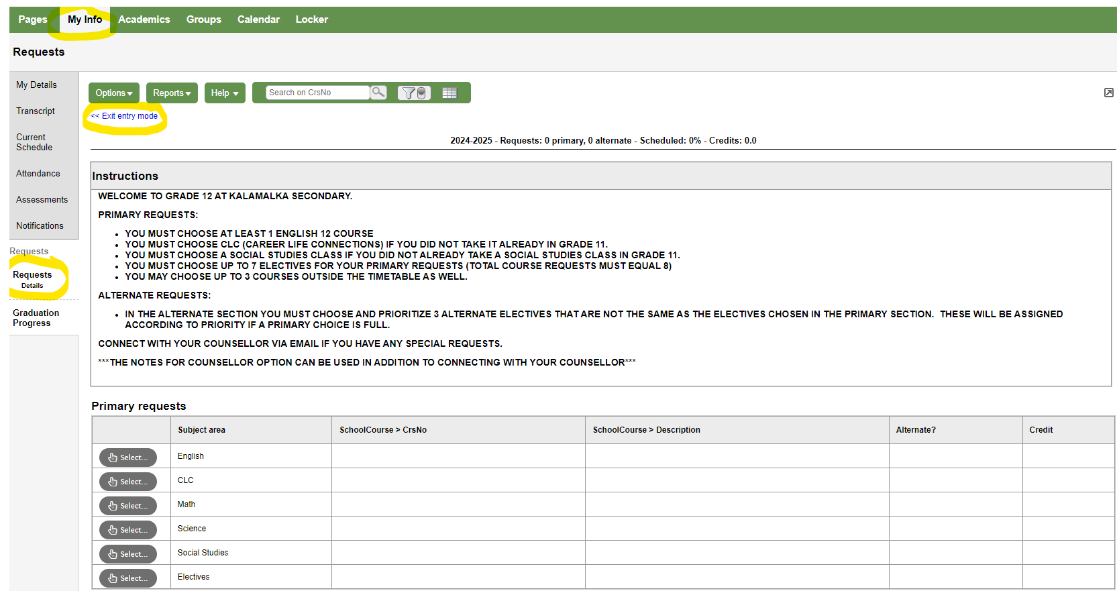

Slide 16
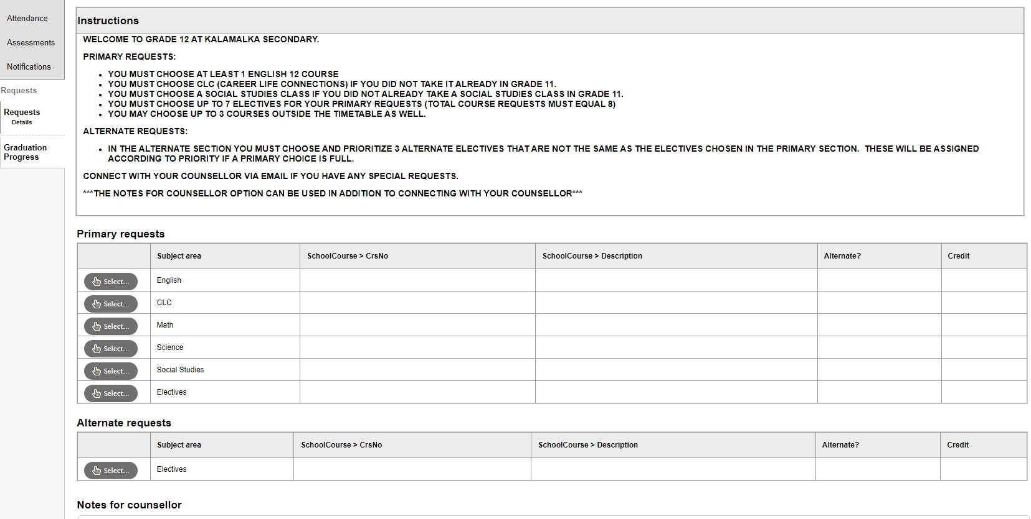
Notes:
Make sure you follow the instructions and search the course codes

Slide 17
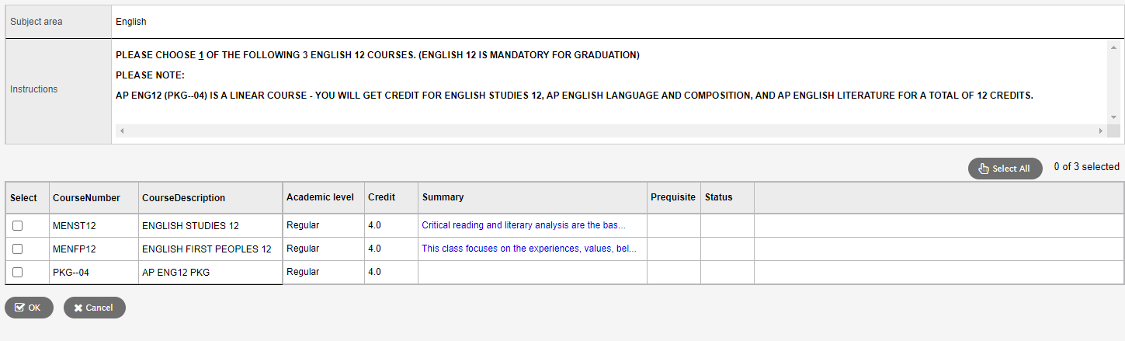

Slide 18
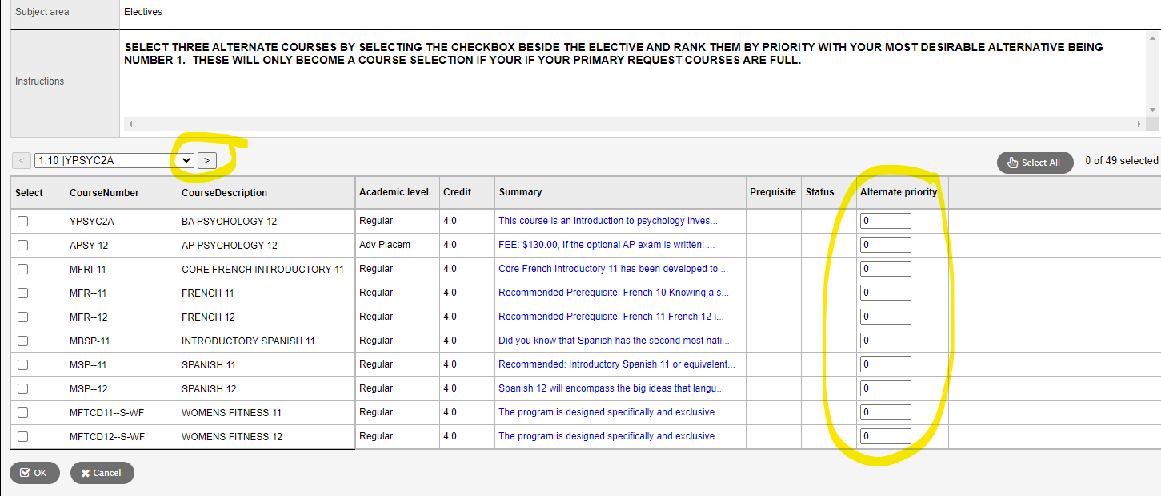
Notes:
Make sure you click on the arrow to see all course options, especially many of the electives!!!
Rank your electives by priority, with most desirable #1

Slide 19
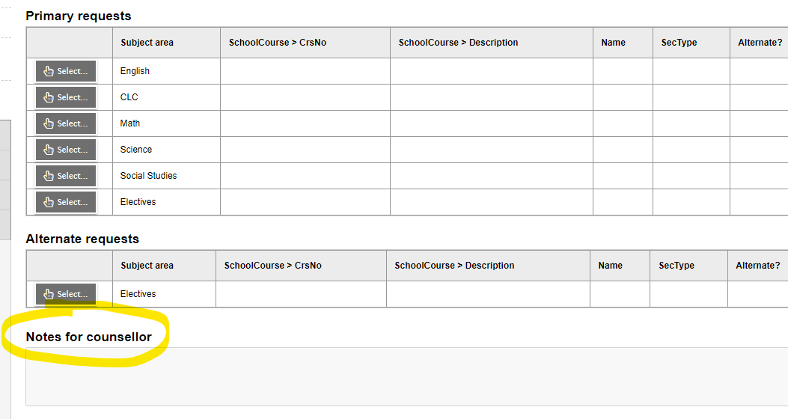
Notes:
Add any special requests or notes for your counsellor, or better yet, speak to them directly. No guarantee that we can accommodate these requests.

Slide 20

So how do I decide which courses to take?
Speaking to the teacher(s) and counsellors
Review course descriptions
Research Post-Secondary Entrance Requirements
Chat with friends who have taken the course

Slide 21
Post-Secondary Entrance Requirements
Do your research!
Review general entrance requirements of the institutions you’re interested in, as well as the specific degree requirements
Learn how each institution makes admission decisions
Work backwards once you’ve identified a post-secondary pathway
While this may seem like a long way out for non-grade 12 students, it will open many doors for you!
Use MyBluePrint to guide your pathway and ensure you have the right courses to graduate and enter your program of choice

Slide 22
What is UBC looking at? | Content | Measurement
1. Overall academic ability | nearly all academic Gr11/12 courses¹ | Overall Average; qualified by depth, breadth, and relevancy
2. Program-specific aptitude | related Grade 11 or Grade 12 course¹ | Core Average; qualified by depth, breadth, and relevancy
3. Key courses | Gr 12 pre-reqs | Course-specific minima
4. Personal profile | short answer questions; activity list | Personal Profile score

Slide 23


Slide 24
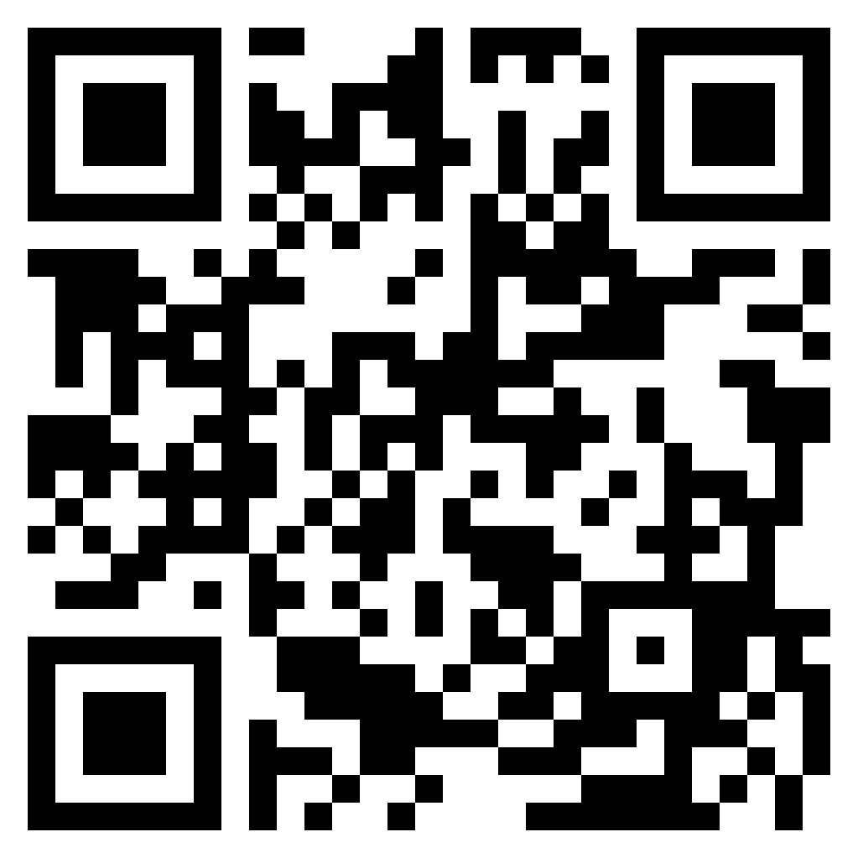
https://kalamalka.sd22.bc.ca/course-selection
YOU GOT THIS!

