Slide 1
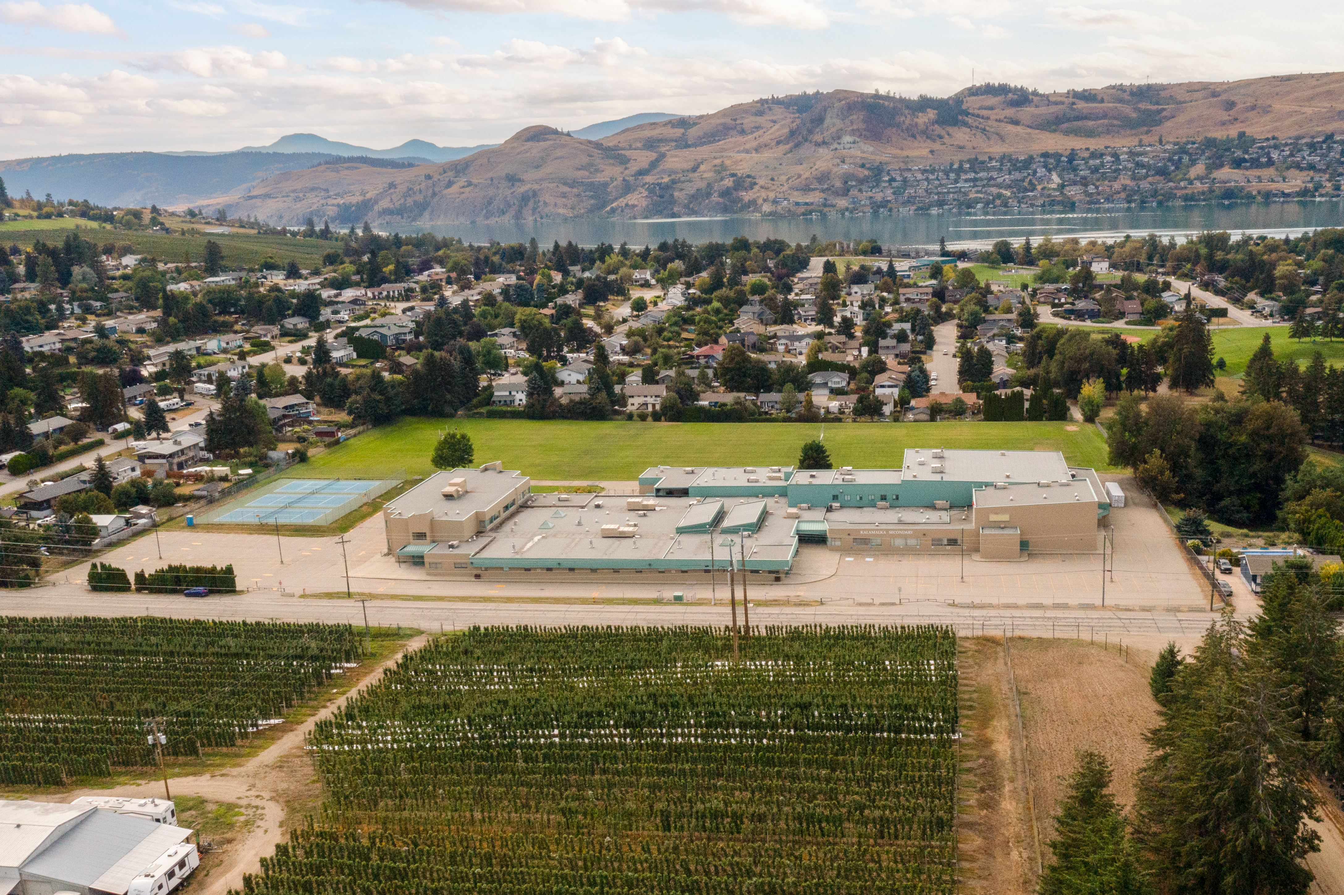

Kalamalka
Gr. 11 COURSE SELECTION 2025/2026

Slide 2

What is course selection?
Courses you want
School schedule
Student ownership
Opens post-Kal doors

Slide 3
What courses can I take?
See Course Planning Book on the Kal website
Each grade has a set of core and elective courses that you can request
Core – classes that are mandatory in each grade
Elective – courses that you choose to take in each grade
As you move through grades 8-12, more of your courses become electives as you focus on a particular area of study

Slide 4
Grade 11
Mandatory courses (5) – must enrol in at least one course from the following learning areas:
1. English 11 – must choose ONE of the following | Creative Writing 11 / Literary Studies 11 / English First Peoples Literary Studies & Writing 11
2. Social Studies – minimum ONE course in gr. 11 or 12 | Explorations in Social Studies 11 (recommended) / Social Justice 12 / Physical Geography 12 / Law Studies 12 / 20th Century World History 12 / Economics 12 / Contemporary Indigenous Studies 12
3. Career Education – must choose ONE of the following in gr.11 or 12 | Career Life Connections 12 (in-class) / Career Life Connections 12 (OTT)
4. Mathematics – minimum one course in gr.11 | Workplace Math 11 / Foundations of Math 11 / Pre-Calculus 11
5. Sciences – minimum ONE course in gr.11 or 12 | Chemistry 11 / Life Science 11 / Physics 11 / Earth Science 11 / Environmental Science 12
Notes:
English – Need FP course in gr.10, 11, or 12 to graduate
Highly recommend SS 11 before gr.12 courses
Most unis need a language 11 for admission

Slide 5
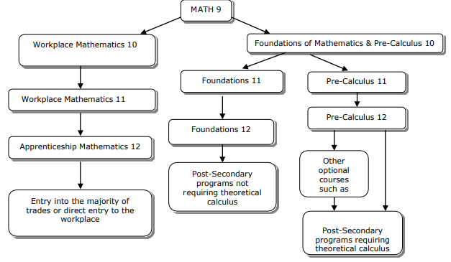

Slide 6
Grade 11
Elective courses (3) - any THREE courses (either from learning area list on slide 4, or from the electives list below)
Psychology 12 | Food Studies 11 | Musical Theatre 11
AP Psychology 12 | Textiles 11 | Theatre Company 11 (School Play)
French 11 | Woodworking 11 | Stagecraft 11
Intro to Spanish 11 | Skills Exploration 11 | Directing & Script 11
Spanish 11 | Art Studio 11 | Peer Tutoring 11
PHE 11 Sports Leadership | Studio Art 2D 11 | Peer Tutoring 11
PHE Active Living 11 | Studio Art 3D 11 | Jazz Band 11 (OTT)
Fitness & Conditioning 11 | Graphic Arts 11 | Chamber Choir 11 (OTT)
Women’s Fitness 11 | Photography 11 | Yearbook 11 (OTT)
Outdoor Education 11 | Concert Band 11 | Leadership 11 (OTT)
Robotics 11 | Drama 11
Notes:
English – Need FP course in gr.10, 11, or 12 to graduate
Highly recommend SS 11 before gr.12 courses
Most unis need a language 11 for admission

Slide 7
BC Certificate of Graduation (aka, Dogwood)
Requires 80 credits in your grade 10-12 years
Most courses = 4 credits
Most students take 8 courses per year
By the end of grade 11, most students will have 64 credits towards their Dogwood

Slide 8
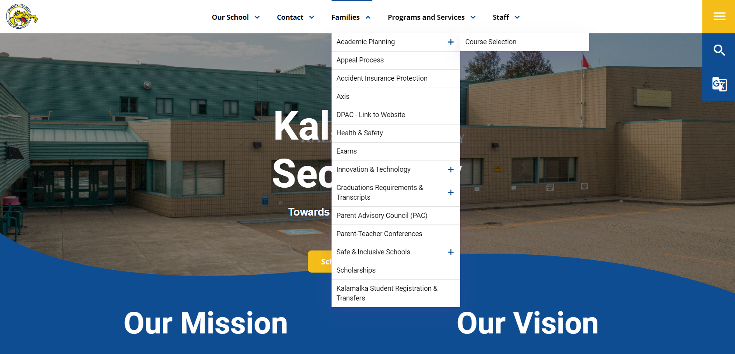
How does course selection work?
Research courses in the Course Planning Book BEFORE course selection day (Tuesday March 4)
Note: not all courses in the Course Planning Book will run ☹ depends on enrolment

Slide 9
How does course selection work?
Before course selection day, log into MyBlueprint and create a Gr.11 Plan
  Ensure you select an English 11 course, a math 11 course, a senior science course, and a senior social studies course
  Ensure you are planning to have 64 credits by the end of Gr.11
On course selection day, refer to this plan when selecting your courses

Slide 10
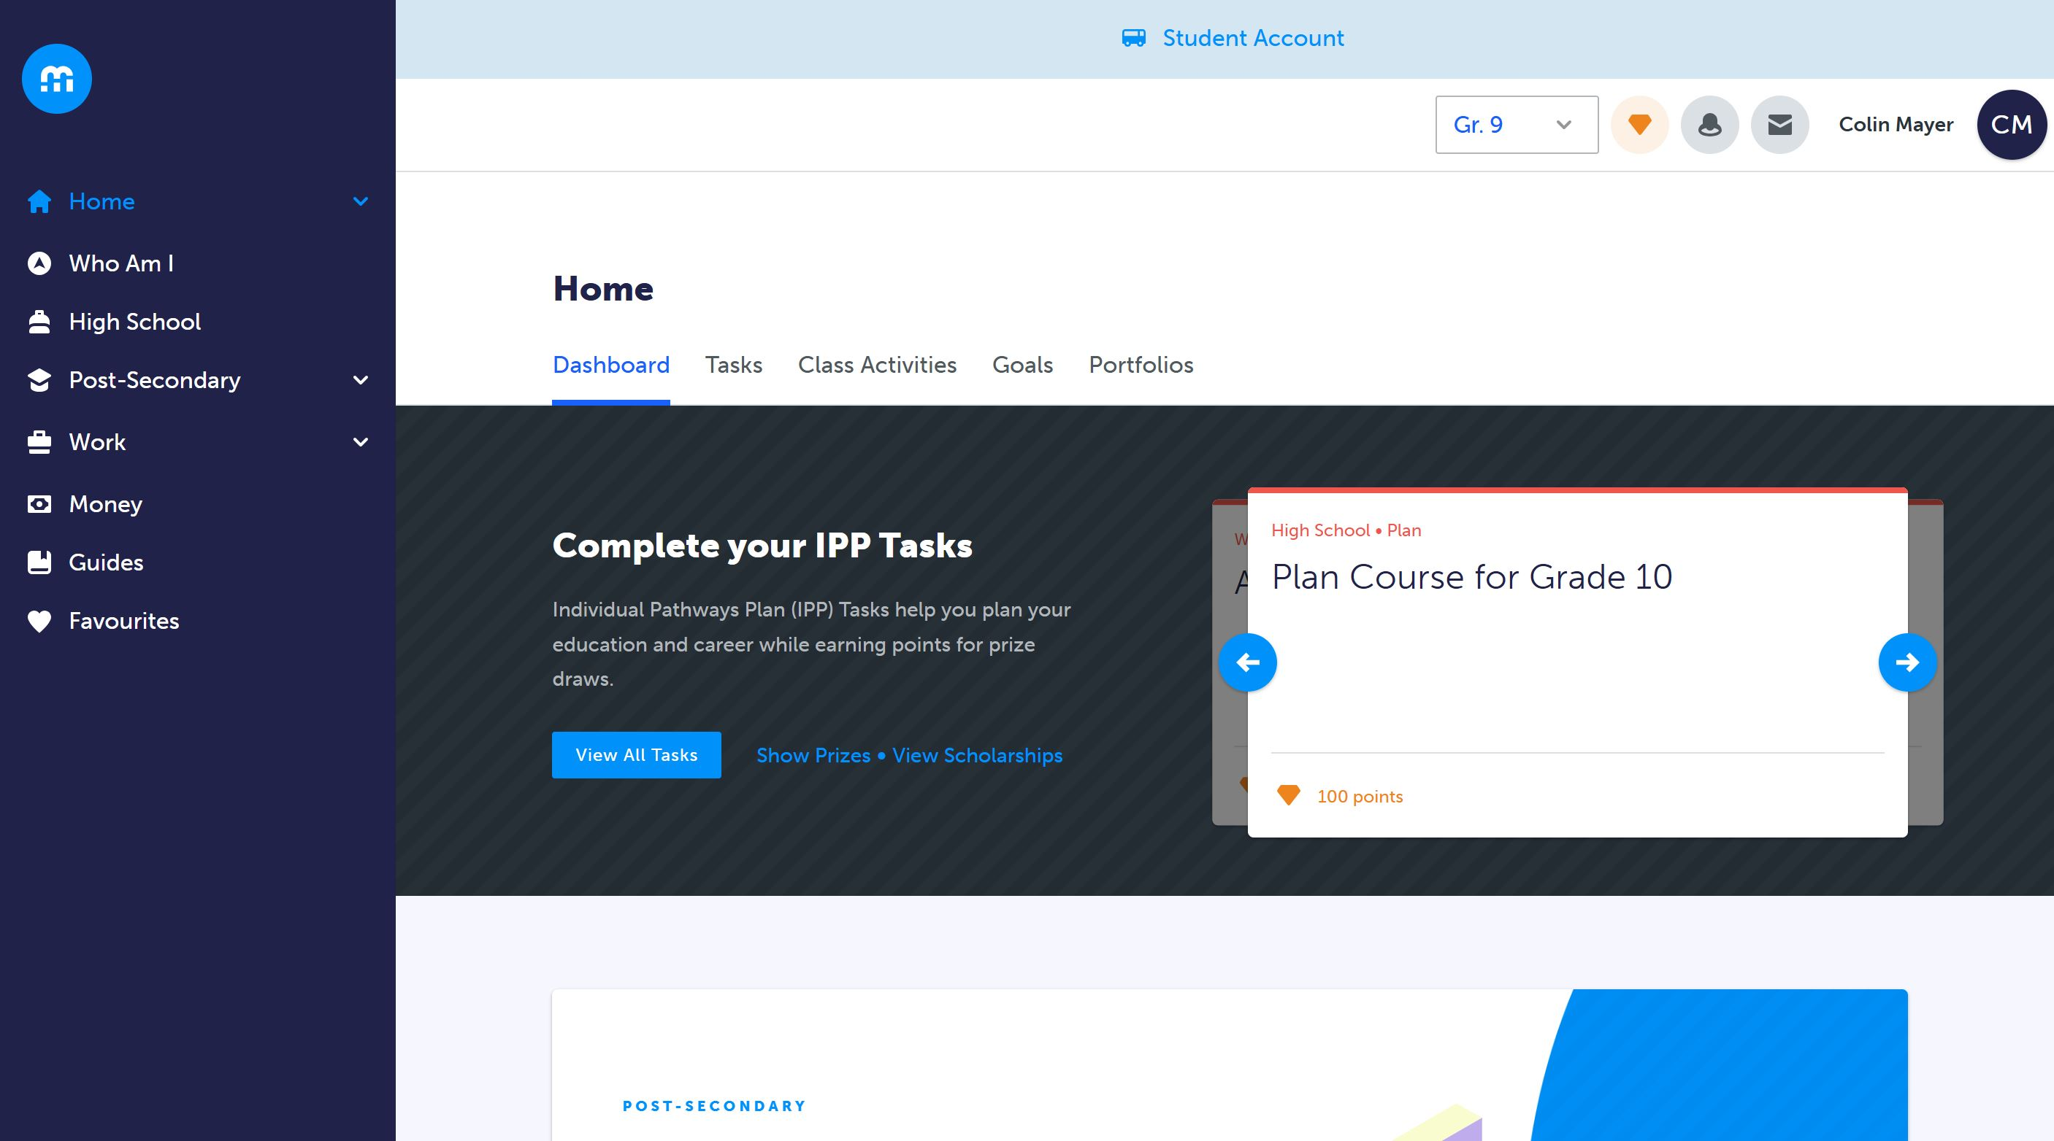
Notes:
Read the instructions before you begin!

Slide 11
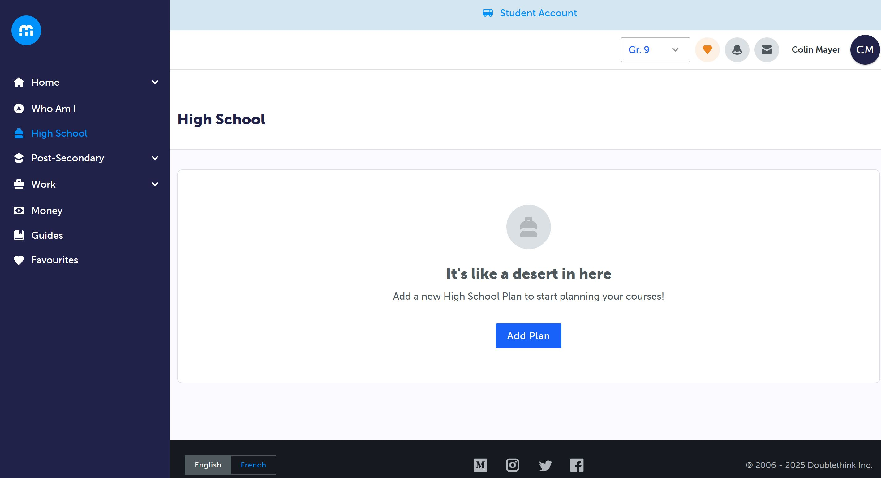
Notes:
Ensure you select all your electives – read the instructions here too!

Slide 12
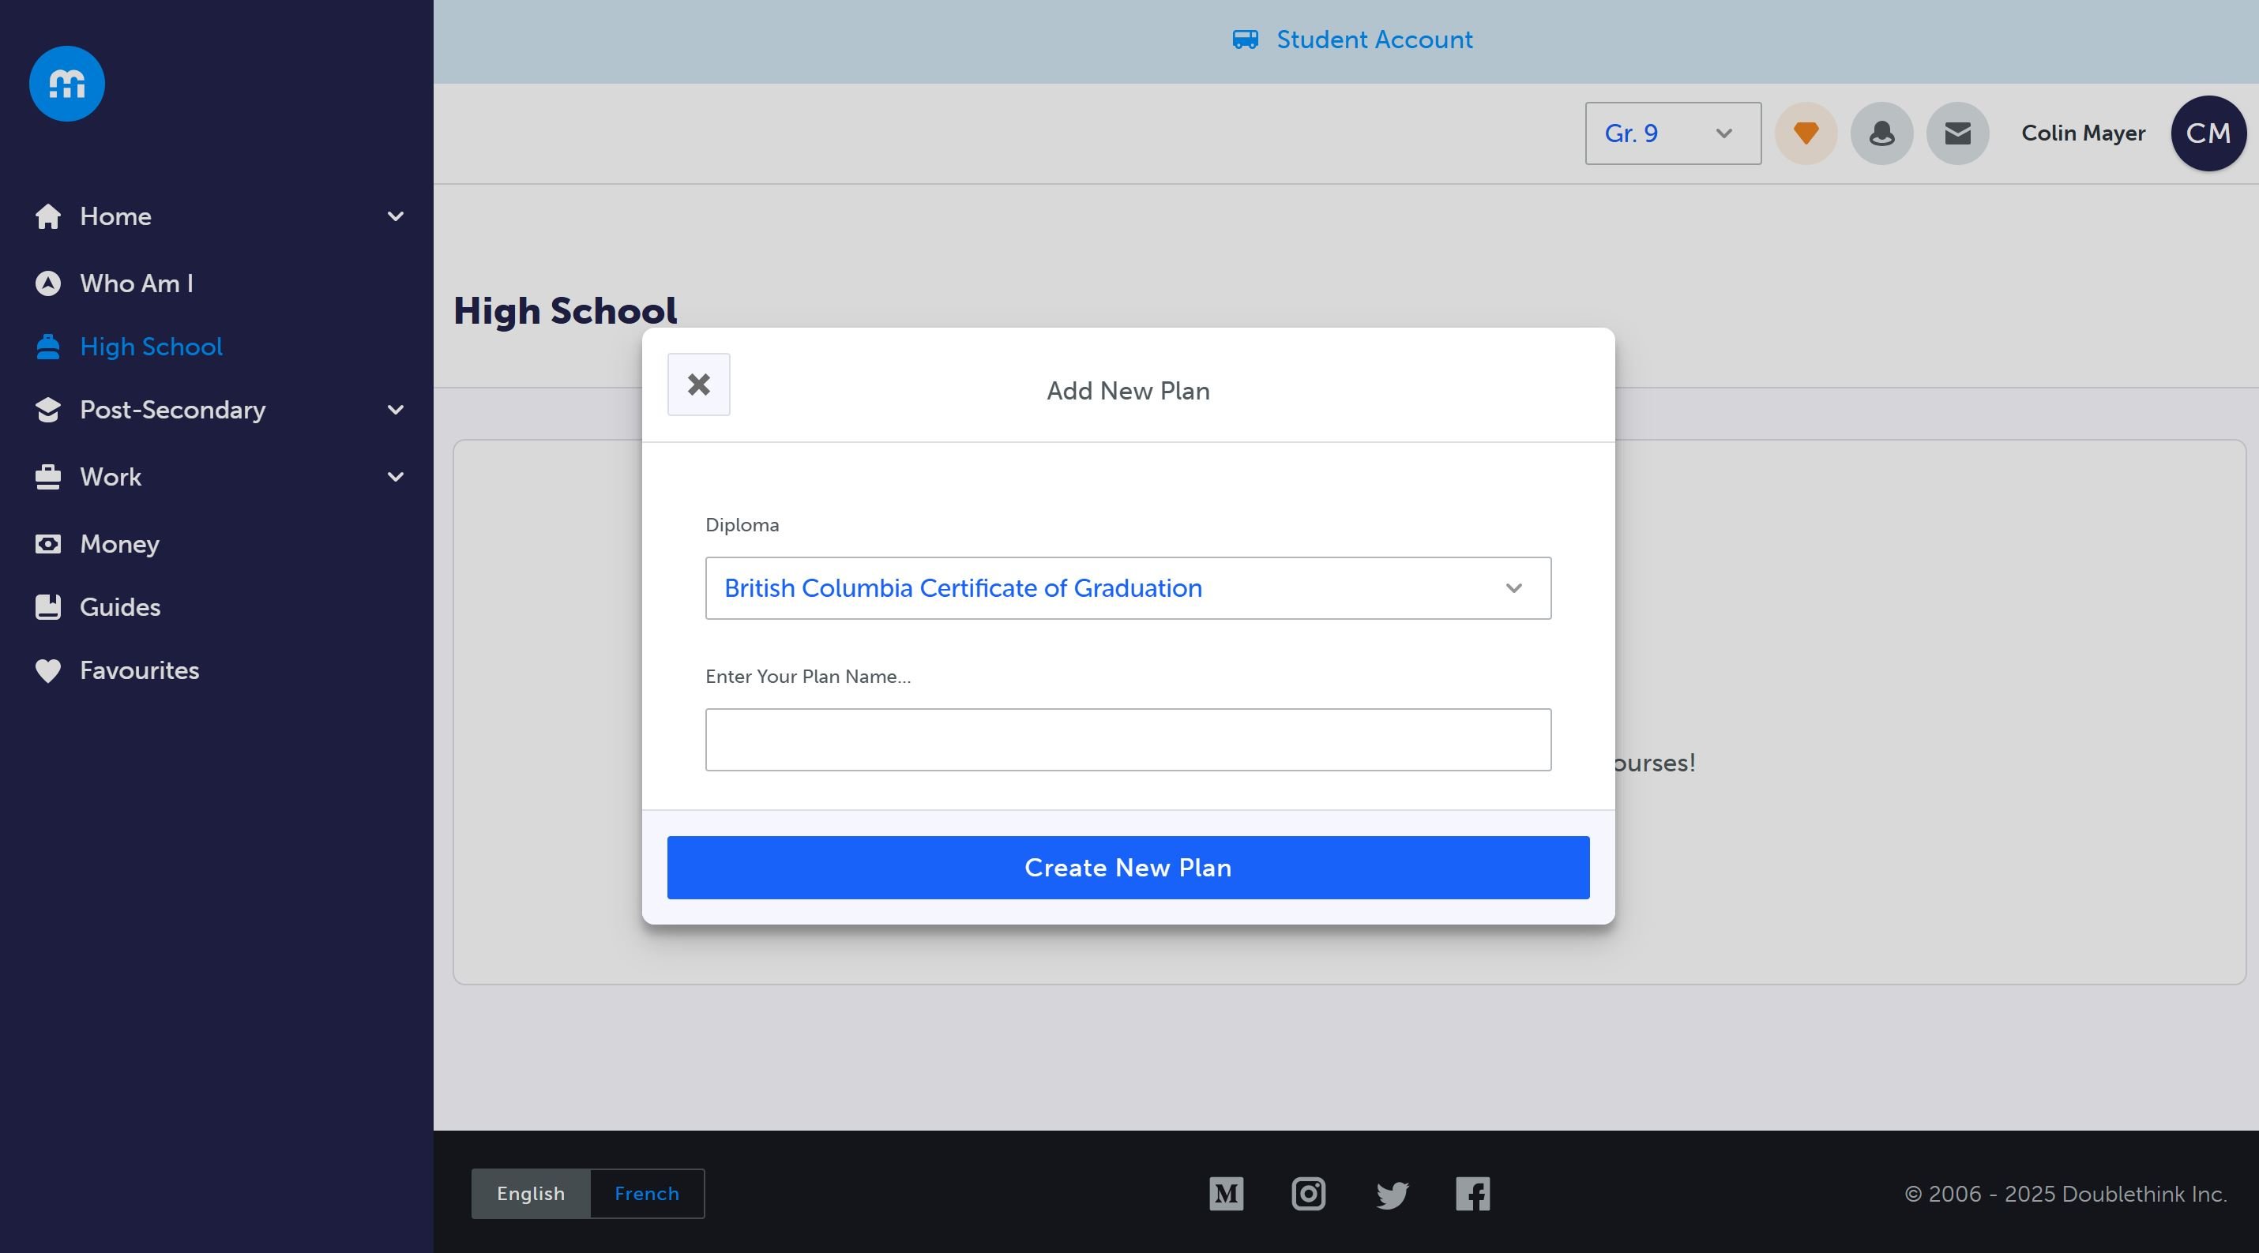
Notes:
Ensure you get your parent / guardian to type their name, and select “Send me an email receipt of my responses!

Slide 13
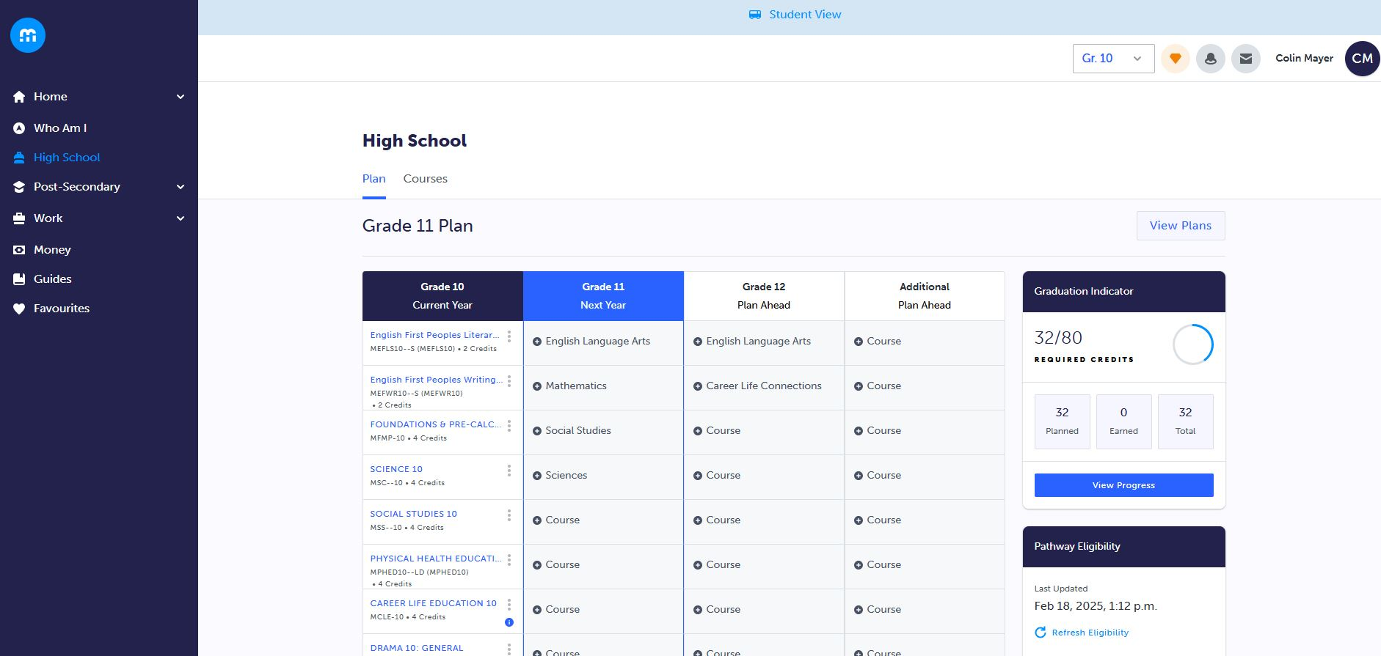

Slide 14
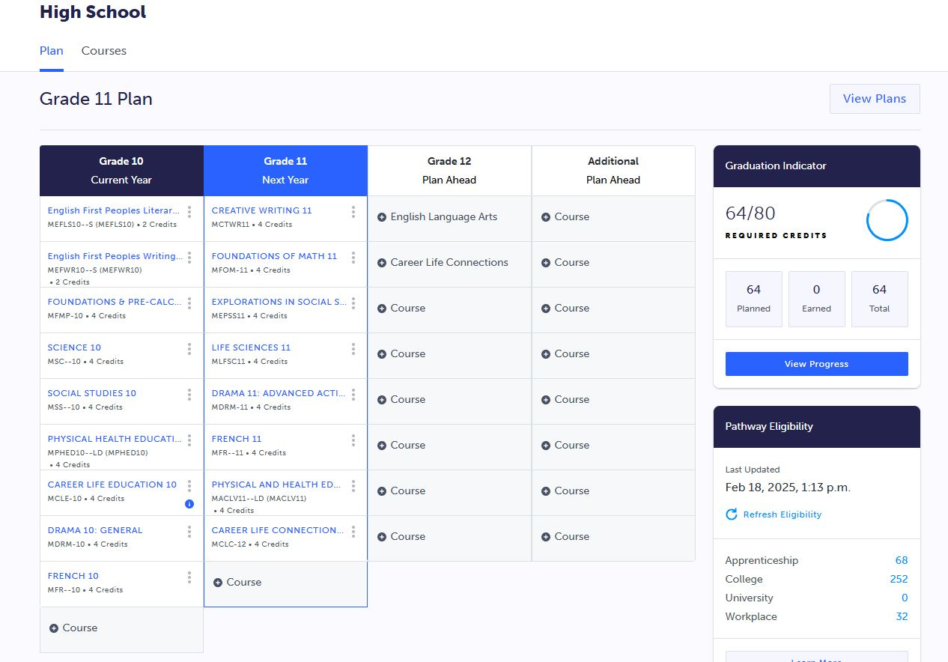

Slide 15
How does course selection work?
On course selection day, log in to MyED > My Info > Requests
Read the instructions!
Select each course (both primary and alternates)
Ensure you have prioritized your alternates, with the most desirable being #1
  If you plan to enroll in an online course or academy, you need to enroll in the in-school course first!
Once you have selected all your courses, ask an admin or counsellor to review your selections to ensure they meet all requirements
Click OK to save all your course requests

Slide 16

So how do I decide which courses to take?
Speaking to the teacher(s) and counsellors
Review course descriptions
Research Post-Secondary Entrance Requirements
Chat with friends who have taken the course

Slide 17
Post-Secondary Entrance Requirements
Do your research!
Review general entrance requirements of the institutions you’re interested in, as well as the specific degree requirements
Learn how each institution makes admission decisions
Work backwards once you’ve identified a post-secondary pathway
While this may seem like a long way out for non-grade 12 students, it will open many doors for you!
Use MyBluePrint to guide your pathway and ensure you have the right courses to graduate and enter your program of choice

Slide 18
What is UBC looking at? | Content | Measurement
1. Overall academic ability | nearly all academic Gr11/12 courses¹ | Overall Average; qualified by depth, breadth, and relevancy
2. Program-specific aptitude | related Grade 11 or Grade 12 course¹ | Core Average; qualified by depth, breadth, and relevancy
3. Key courses | Gr 12 pre-reqs | Course-specific minima
4. Personal profile | short answer questions; activity list | Personal Profile score

Slide 19


Slide 20
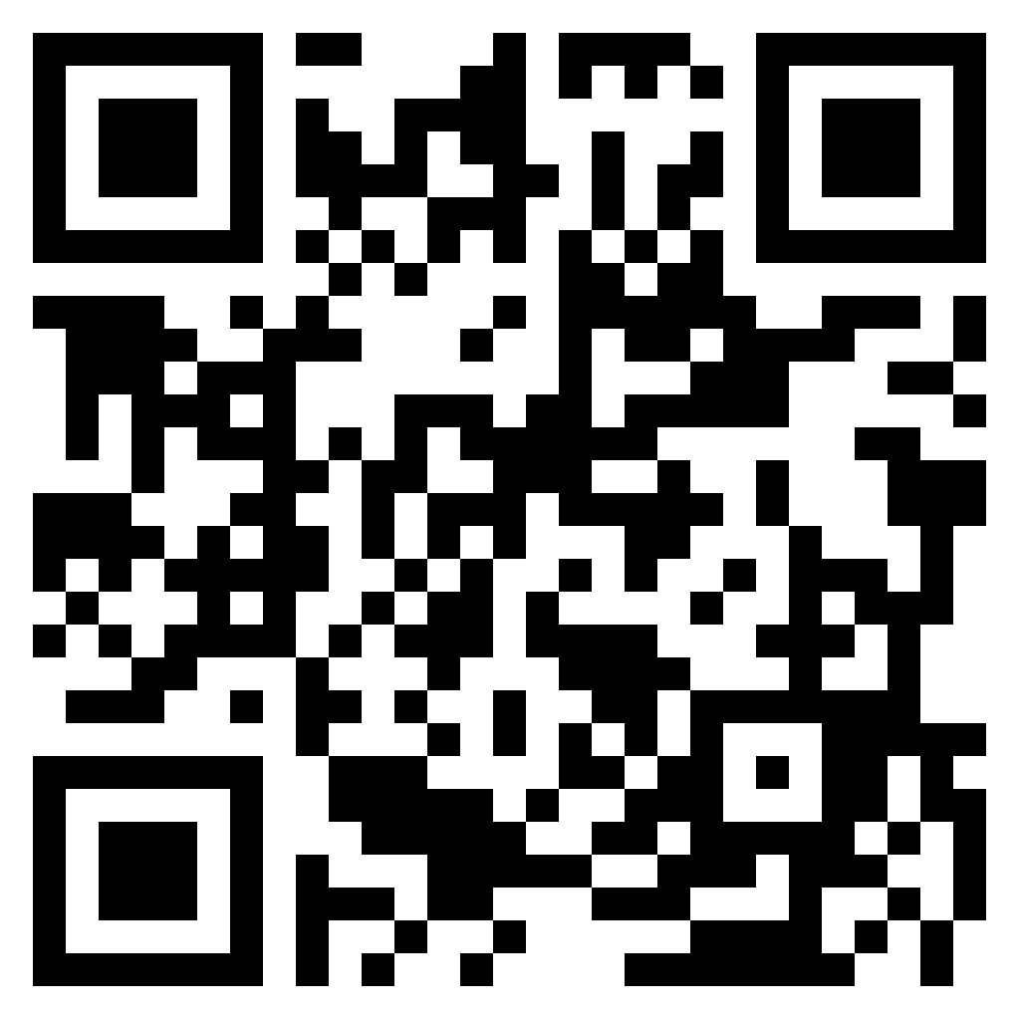
https://kalamalka.sd22.bc.ca/course-selection
YOU GOT THIS!

