Slide 1

Kal Scholarship & Post Secondary Information
2021-22
IN

Slide 2

BASIC GRADUATION REQUIREMENTS
80 Credits from grade 10, 11 & 12
16 Credits MUST BE Gr.12 Courses
28 Elective Credits
4 Fine Arts OR Applied S k ills C re d it
Each course is equal to 4 credits
·

Slide 3
PLEASE CHECK YOUR TRANSCRIPT TO ENSURE YOU HAVE ALL OF THESE REQUIREMENTS MET
There are 52 credits (13 courses) required for Graduation:
Career-Life Education (4 credits)
Career-Life Connections (4 credits)
Physical and Health Education 10 (4 credits)
Science 10 (4 credits) and Science 11 or 12 (4 credits)
Social Studies 10 (4 credits) and Social Studies 11 or 12 (4 credits)
A Math 10 (4 credits) and A Math 11 or 12 (4 credits)
An English 10, 11 and a required 12 (12 credits total)
Fine Arts Education 10, 11, or 12 or Applied Skills, 10, 11, or 12 (4 credits total)
There are 28 credits (7 courses) elective courses required for Graduation
These are any courses other than required courses
Students must also Complete these assessments:
Grade 10 Numeracy Assessment
Grade 10 Literacy Assessment
Grade 12 Literacy Assessment

Slide 4
If you are involved in activities outside of school,
you may qualify for external Credits!
Use the following site to see if your extracurricular activity qualifies for 2 or more credits.
http://www2.gov.bc.ca/gov/content/education-training/k-12/support/graduation/getting-credit-to-graduate/external-credentials

Slide 5

Work
Post-Secondary
Travel
Gap Year

Slide 6







You have many options!
Post –Secondary
Travel
Work
Gap year

Slide 7

The following sites can help you plan the next steps…

Slide 8

http://www.educationplanner.ca
A great resource for searching programs, admissions requirements, and other details regarding post-secondary options in BC.

Slide 9

http://www.workbc.ca/Pages/Home.aspx
This site provides info about….
Career-Related Statistics
Career Exploration
Jobs
Education & Training

Slide 10

College
Or
University?

Slide 11

There are many pros to attending a BC College:
Many colleges offer the same courses/programs as universities
Tuition is lower
You can live at home
Class sizes are smaller
Likewise, Universities can offer:
More choice
Complete programs of both undergraduate and graduate degrees
Leading research and/or top-ranked faculties

Slide 12
Post-Secondary Entrance Facts
Each PSI (Post-Secondary Institution) Has Specific Entrance Requirements
Each Faculty I Program Also Has Entrance Requirements
Each PSI Sets Their Own Minimum Grade/Average for Entrance
Each Year The Minimum GPA Needed For Entrance Changes
* Many students who only meet the minimum requirements for Entrance are NOT accepted as students with higher marks get in first
It is your Responsibility to Visit your PSI Website for specific Info!

Slide 13






G.P . A. is calculated by using ….
English 12 and other 'admissible' courses determined by your university and program of choice
This average is what establishes your RANK among the applicants
*Elective courses NOT required for entrance may be omitted when calculating your average (check with PSI)
October 6, 2015
15

Slide 14
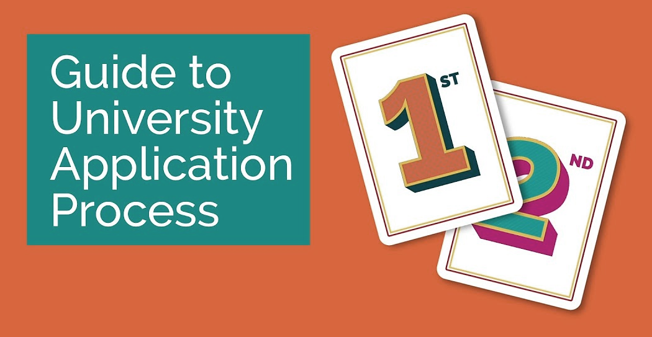
How Do I Apply for
College or University?
Most Provinces Have a Centralized System
October 6, 2015
15

Slide 15






Examples of Central
Systems
OR
Apply Directly To the University/College Via Their Website

Slide 16
ALL PSI’s HAVE An Online Application Process
It is recommended to apply to a minimum of two schools
 Keep options open
 Programs can be VERY competitive
 Applications require a fee for processing which is non-refundable
(credit card, cheque or in person payment)

Slide 17
What do I need to apply?
Name, phone number , etc.
Personal Education Number (PEN)
Social Insurance Number (tax receipt)
Grade 10 and 11 Marks (Transcript)
CREDIT CARD!

Slide 18
How To Submit Transcripts
To A Post-Secondary Institution
Create a BCEID
https://www.bceid.ca/
2. Follow the steps on the Ministry
site to have your transcripts released

Slide 19

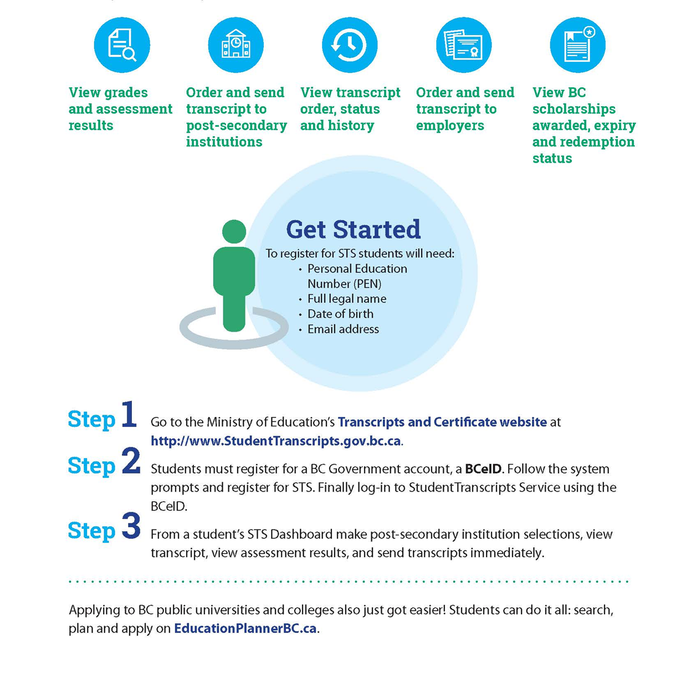

Slide 20

Applying For Student Loans
Must have applied to, and been accepted into your program
Application available AFTER June 1^{st 2022}
ONLINE version … QUICKEST
Paper version available
https://studentaidbc.ca/
24

Slide 21
How Are Student Loans Calculated?
Amount varies according to…
Student & Parental contribution (Need)
Cost of program
*Must be enrolled as a ‘full-time student’
*A Weekly maximum of $320 OR $8960 for one year of College/University
*Life-Time Max of 50,000
6, 2015
25

Slide 22




Slide 23

Various Types of Financial Acknowledgement
Award: Is given in recognition of outstanding achievement. May be in the form of books, plaques, or monetary reward.
Bursary: A non-repayable grant of money, bursaries are awarded primarily based on financial need, but academic achievement is also considered. Usually, the applicant must provide detailed documentation describing their financial situation when applying for a bursary.
Scholarship: A non-repayable sum of money awarded to a student to help finance further education. Most scholarships are based on merit in areas ranging from academic achievement to athletics. Usually, scholarships are not based on financial need.
Entrance Award/Scholarship: A scholarship or award given to a student entering his/her first year at a post-secondary institution. Also referred to as an Admission Award which is offered by the Post Secondary Institution.
In-course Award/Scholarship: Awarded to students already enrolled in post- secondary studies, beyond the first year level.
7

Slide 24


International/National
University Entrance
Ministry of Education
School District
# 22
LOCAL
District Project
# of students competing
$ $ $ available

Slide 25
National / International/Provincial
Very Competitive
Numerous Applicants ➔ Few Recipients
Grades plus factors specific to the organization
(humanitarian service/ innovator/leader)
Applications are comprehensive, often requiring reference letters, nominations, essays and transcripts
Example: Loran Scholarship over 5000++ applicants
36 Recipients

Slide 26




College / University Entrance Scholarships
Institution Specific: based on
grades and/or involvement with sport/leadership/volunteer activities
Application Process
An application form must be completed
or
automatic consideration when you apply

Slide 27

School District /Local Scholarships
Recipients are Determined by ;
Representatives from the
Business/Organization/Donor
SD#22 District Selection committee
Kal School Committee
(Teachers, Admin, Counsellors)
Factors considered in selection:
Grades, Community Service, Affiliation,
Acceptance to post secondary, Volunteer,
Leadership
ONLINE Application Opens in March 2018
MUST be completed Online at School

Slide 28

http://www.sd22.bc.ca/Programs/career/apprenticeship/Pages/default.aspx
School District #22 Local Scholarships
Scholarships/Bursary/Awards are offered to our students by Local Organizations
Applications for these scholarships open March 2022
Applications Must be completed Online
You will only have 2 weeks to complete the online application
.
This Photo by Unknown Author is licensed under CC BY

Slide 29
The BC Ministry of Education Offers the Following….
BC Excellence Award
Top 55
$5000.00
BC Achievement Top 8000 $1250.00
Pathway To Teacher Education Top 20 $5000.00
http://www2.gov.bc.ca/gov/content/education-training/k-12/support/provincial-scholarships

Slide 30
BC Excellence Award
$5000.00
Awarded to 55 Grads in BC
Students must be nominated by their school (one per school)
“B” average (Grades 11 and 12) in required courses
Community service, volunteer activity, and/or leadership
Must Submit:
Resume
Two references letters
Written statement (maximum 500 words)
https://www2.gov.bc.ca/gov/content/education-training/k-12/support/scholarships/provincial-scholarships/bc-excellence-scholarships
October 6, 2015
35

Slide 31
BC Achievement Scholarships
$1250.00
Awarded to the top 8000 B.C. grads with the highest cumulative average of ALL courses
The Ministry will determine recipients based on students’ achievement in Grades 10, 11, and 12 courses that satisfy graduation program requirements (including elective courses).
A student can receive only one BC Achievement Scholarship in their lifetime.
The Ministry will mail this Scholarship directly to students by October of their Grad year (2022)
36
October 6, 2015
http://www2.gov.bc.ca/gov/content/education-training/k-12/support/provincial-scholarships/bc-achievement-scholarships

Slide 32

Pathway to Teacher Education Scholarship
awarded to 20 outstanding high school graduates who's career path is K-12 teaching.
$5000 Tuition Scholarship
A student cannot win both a Pathway to Teacher Education Scholarship and a BC Excellence Scholarship.
http://www2.gov.bc.ca/gov/content/education-training/k-12/support/provincial-scholarships/bc-achievement-scholarships

Slide 33
District Project-Based Scholarship
Opportunity to recognize student achievement in a specific area of interest
Numerous $1250 awards are presented
*Applications To be completed Online
Info Session, End of October
See Mr. Grace or Mrs. McDonald for more info
http://www.sd22.bc.ca/Programs/scholarship/Pages/default.aspx

Slide 34
District Project Based Scholarship Categories
Fine Arts
 e.g., Visual Arts, Dance, Drama, Music
Applied Skills
 e.g., Business Ed, Technology Ed, Home Economics
Physical Activity
 e.g., Athletics, Dance, Gymnastics, not limited to Physical Education
Second Languages
Community Service
Volunteer Activity
Technical and Trades Training
 e.g., Carpentry, Automotive, Mechanics, Cook Training
District/Authority Scholarships will consist of PSI vouchers only.

Slide 35
Secondary School Apprenticeship Scholarship
$1000
Must be registered with the SD#22 Apprenticeship Program prior to graduation
automatic consideration for the award
This student will be a 2022 Graduate
Maintained a C+ average on Grade 12 courses
Reported a total of at least 900 hours to the ITA within six months of graduation
http://www.sd22.bc.ca/Programs/career/apprenticeship/Pages/default.aspx

Slide 36



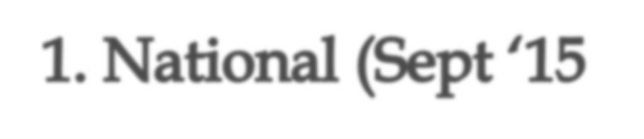







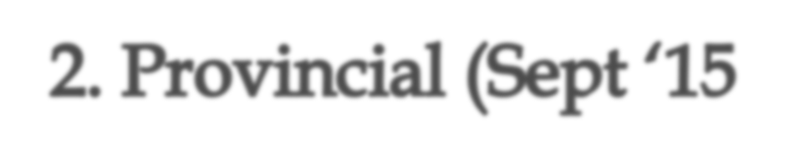





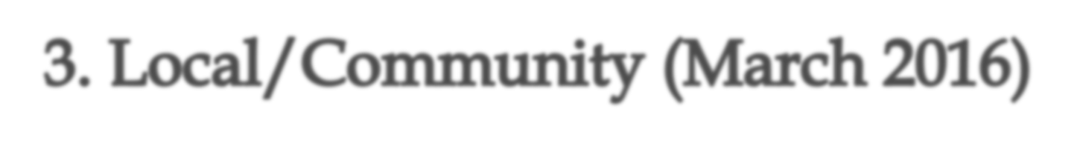






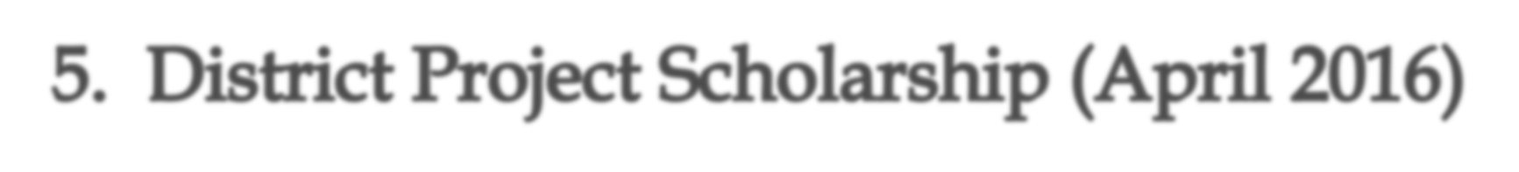



Sept ’21– Sept ‘22
Sept ’21– Sept ‘22
Sept ’20 – Sept ‘19
March 2022
4.
Varies
April 2022
April 2017
Projects Must Be Based on Courses Taken At Your School

Slide 37



Some Scholarships already have applications available, others open throughout the year
Most Scholarships are due between Feb – April
Important that your resume is current
Important that you have letters of reference to support your application(s) - CRUCIAL TO VERIFY SERVICE ACTIVITIES
Important that you PAY ATTENTION to deadlines.
October 6, 2015
https://www.lrsd.net/schools/CB/AboutUs/Documents/SCHOLARSHIP%20APPLICATION%20TIPS.pdf
42

Slide 38
Scholarship Factors To Consider
Year of Study (entrance, first year, final year, graduate)
Special Circumstances (visual impairment, orphan, etc.)
Financial Need
Academic Average (GPA)
Field of Study (the program you’re interested or currently in)
Affiliation (companies, religious groups, unions, and associations, that you or your family are affiliated with)
Activities (sports, religious, academic, leadership, community involvement, etc.)
October 6, 2015
43

Slide 39
Tips For Reference Letters
Consider carefully which teachers (or community person) from whom you may need a reference letter
The person you ask should know you VERY well so that they can write a meaningful letter. Their title is not as important as their ability to reference personally about you and your strengths.
Supply your reference with a copy of your resume
Allow your reference at least 2 weeks to write the letter
If you would like their letter for multiple applications, request that they print several copies for you at the same time
They may request that the letter remains confidential in which case it will be placed in your file, however, multiple copies will not be made
Please DO NOT request a letter unless you intend to use it
REQUEST YOUR LETTER WELL IN ADVANCE OF YOUR DEADLINE
44

Slide 40
















Slide 41



Additional Scholarship Resources
Studentawards.com
Scholarshipscanada.com
015
46

Slide 42



Scholarship Myths

Slide 43






Most of the time it is more about what you write than how well it is written.
Whether you follow the instructions and address the essay question is more important than how well you write.

Slide 44


If I Am A Top Academic Student, I will Get a Full Scholarship
…few students get full scholarships
Always explore other options available
  -Ministry of Education bursaries
  -Student loans
  -Part-time work

Slide 45

I should apply to as many scholarships as possible to increase my chances
True…but…
You should apply only for those scholarships that you would be well suited for , and that you stand a good chance of winning.

Slide 46

Only Honour Roll Students get scholarships
Grades are important, however , they are only 1 way that students are measured and evaluated.
Many scholarships consider multiple aspects of your secondary experience, NOT just marks!

Slide 47

I need to have a lot of extracurricular / volunteer hours
Its about quality , not quantity.
Most recipients demonstrate leadership, specialization or excellence in their chosen areas

Slide 48

www.volunteervernon.ca

Slide 49





www.studentawards.com www.schoolfinder.com www.scholarshipscanada.com www.youthcanada.ca www.achievebc.ca
www.pas.bc.ca/resources/financial.htm (apply online)
www.edupass.org
.S. bound students)
October 6, 2015
48

Slide 50
Scholarship Resources Continued…
www.studentscholarships.org
www.bcscholarships.ca
www.ammsa.com
www.nursingscholarships.ca
www.nupge.ca/sholarships
www.engineeringscholarships.ca
www.listofscholarships.ca
www.aucc.ca
www.bcschoolsports.ca
www.canlearn.ca
www.cdnprincipals.org/AWARDS.htm
www.chfscholarships.com
www.loranawards.ca
www.yconic.com

Slide 51

Register Here!
Virtual Fair - Post-Secondary BC (postsecondarybc.ca)
November 3, 9, 18
December 1, 7
9:00AM-7:00PM

Slide 52
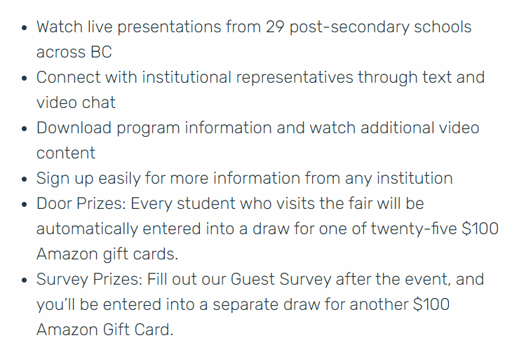

Slide 53


Post-Secondary In-Person Visits and Virtual Sessions
Okanagan College, Vernon campus
Program Open House & Spotlight Sessions on November 2nd and 15th
First Year FAQs Seminar on November 8.
University of Calgary
@ Kalamalka Secondary, Friday November 19th 2pm-3pm
-listen to the announcements for more details.

Slide 54


Thompson Rivers University
@Kalamalka Secondary on Wednesday November 24 from 2pm -3pm listen to the announcements for more details.
Queens University
https://www.queensu.ca/admission/webinars

Slide 55
Further Questions?
Contact Us
Mrs. Knight (a-l)
lknight@sd22.bc.ca
Mr. Landry (m-z)
alandry@sd22.bc.ca

